Slide 1

RDF and Sparql essentials

Slide 2
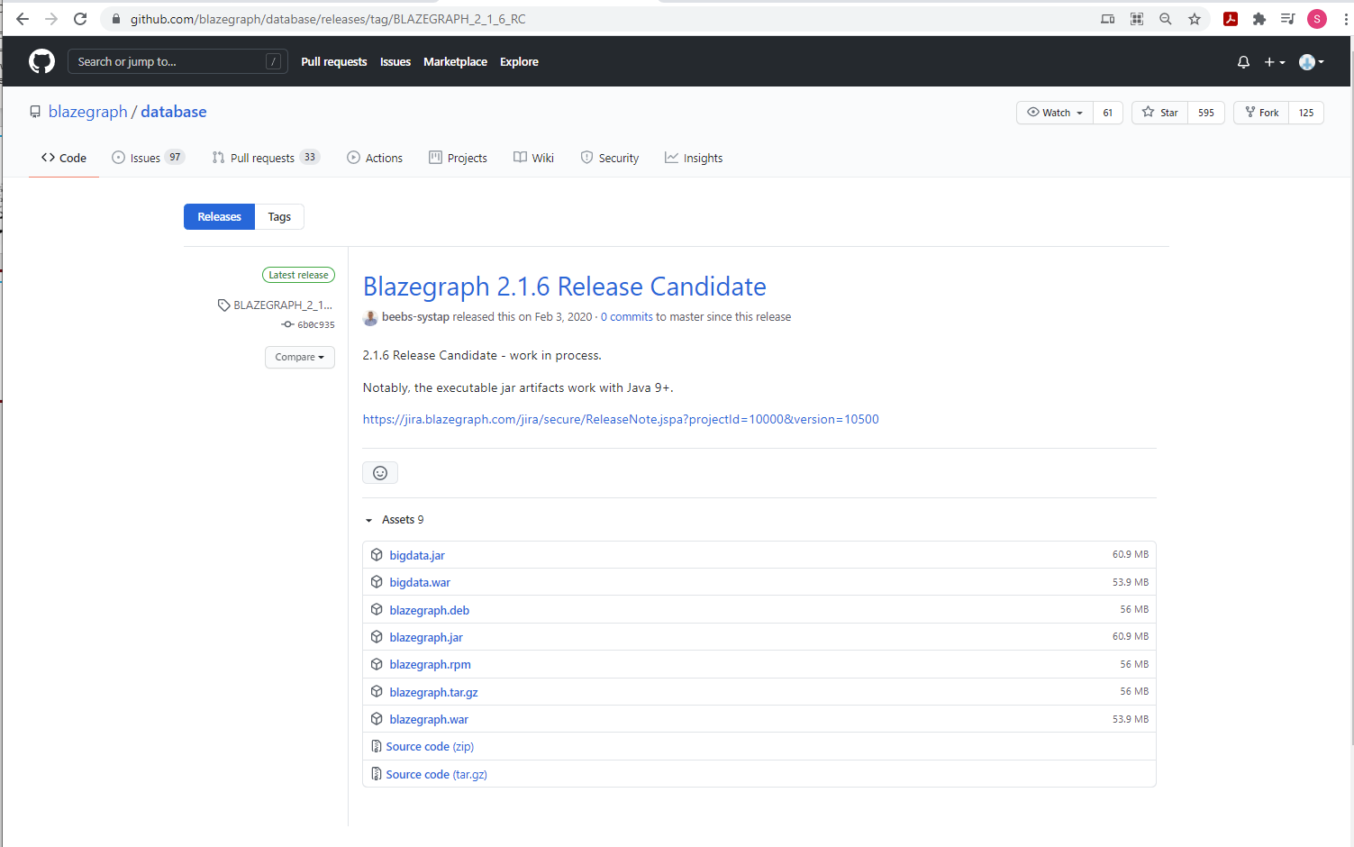
Blazegraph

Slide 3
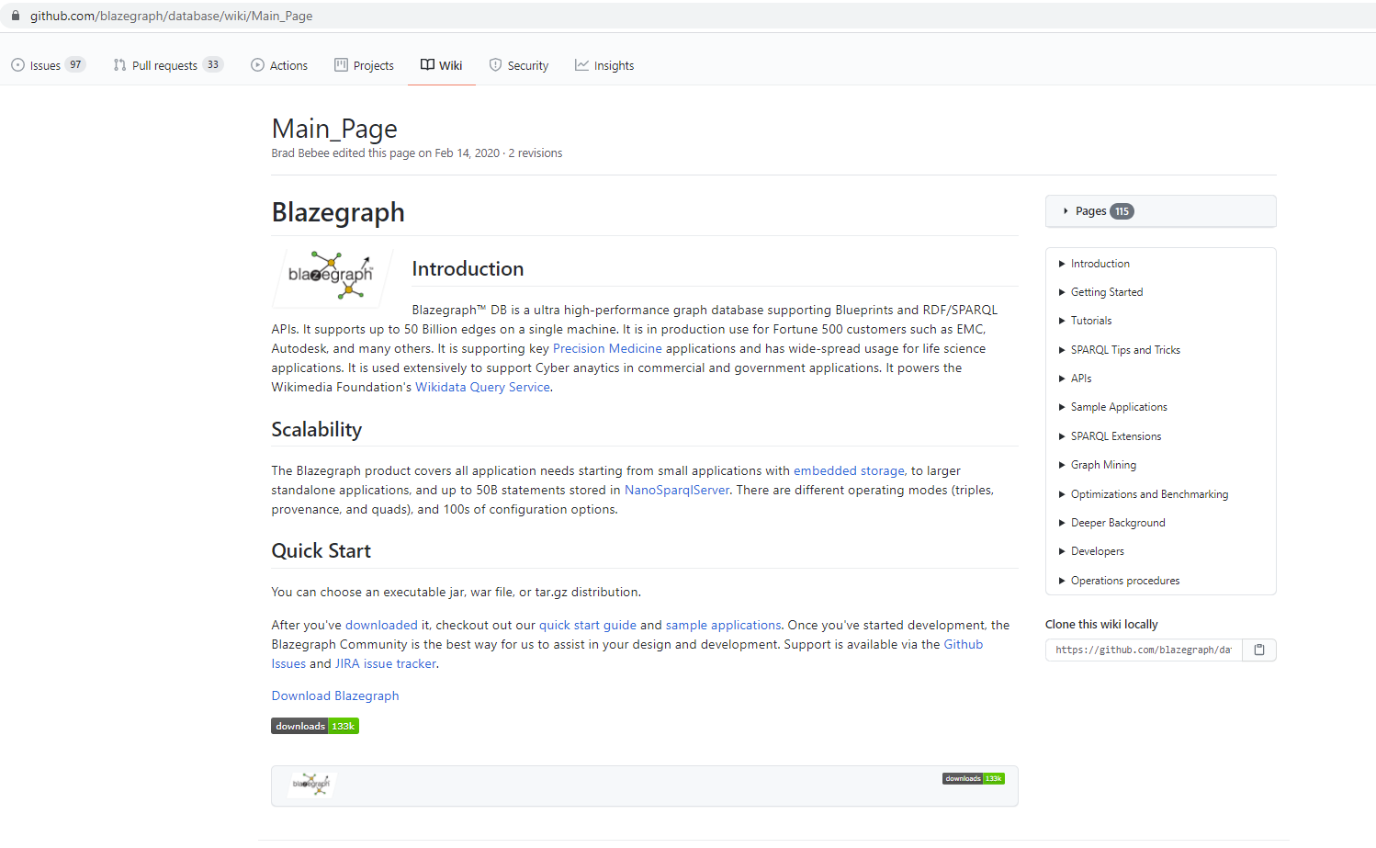
Getting started
https://github.com/blazegraph/database/wiki/Main_Page

Slide 4
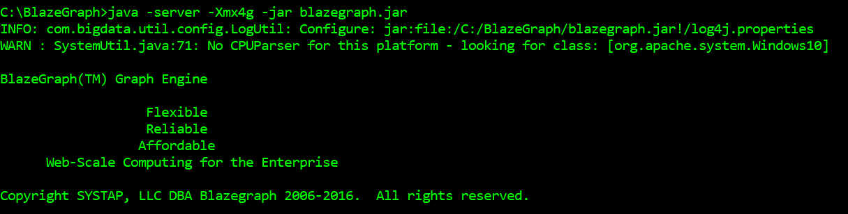
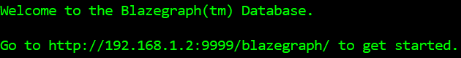
Quick start – 1/2
https://github.com/blazegraph/database/wiki/Quick_Start

Slide 5
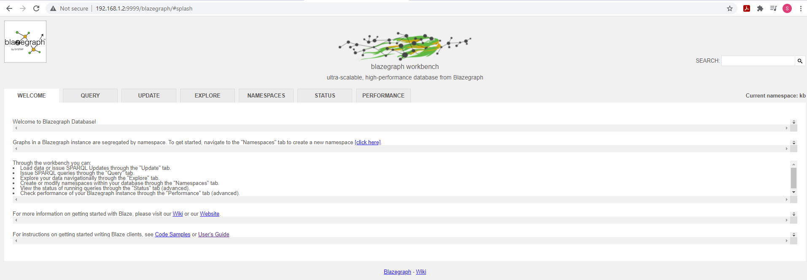
Quick start – 2/2
https://github.com/blazegraph/database/wiki/Quick_Start

Slide 6
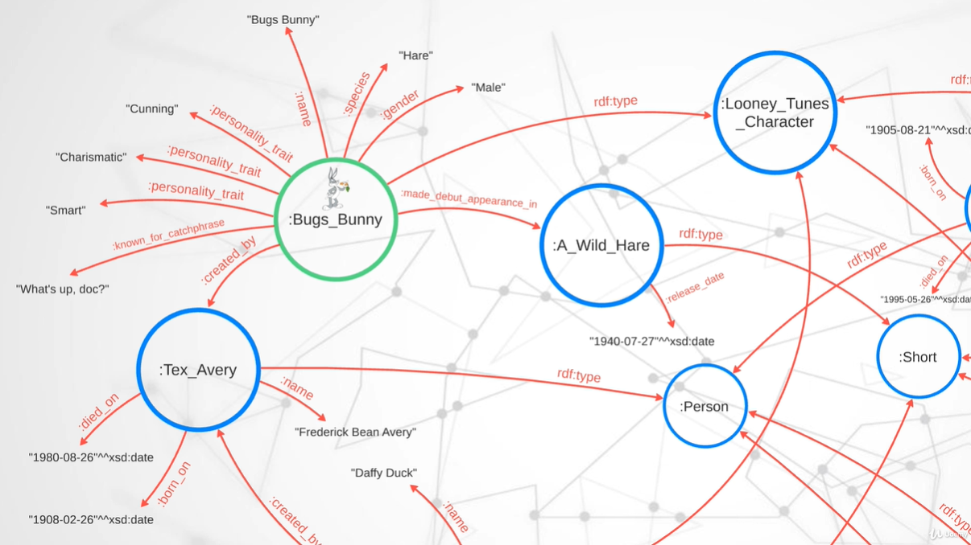
Default IRI and writing RDF triples involving literal values – 1/n

Slide 7
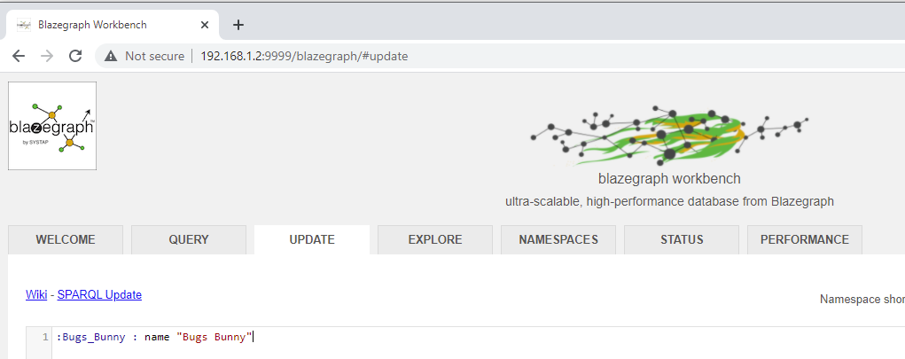
Default IRI and writing RDF triples involving literal values – 2/n
:Bugs_Bunny : Uses snake case convention. Can also use camel case if you like to.
:name : Can use snake case convention.
Colon (:) means default namespace

Slide 8
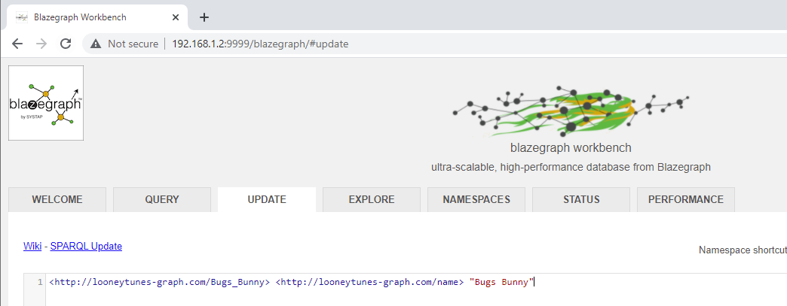
Default IRI and writing RDF triples involving literal values – 3/n
IRIs written following the convention of URI’s. These IRI’s need not be accessed across web and used only for
unique identification.

Slide 9
Default IRI and writing RDF triples involving literal values – 4/n
IRIs written following the convention of URI’s. These IRI’s need not be accessed across web and used only for
unique identification.

Slide 10
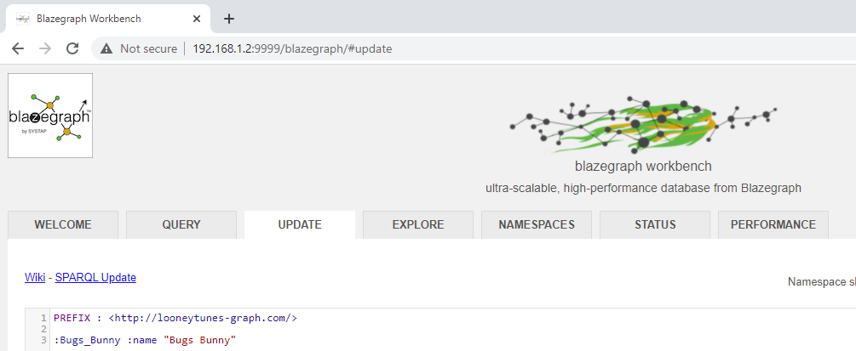
Default IRI and writing RDF triples involving literal values – 5/n

Slide 11
Default IRI and writing RDF triples involving literal values – 6/n

Slide 12
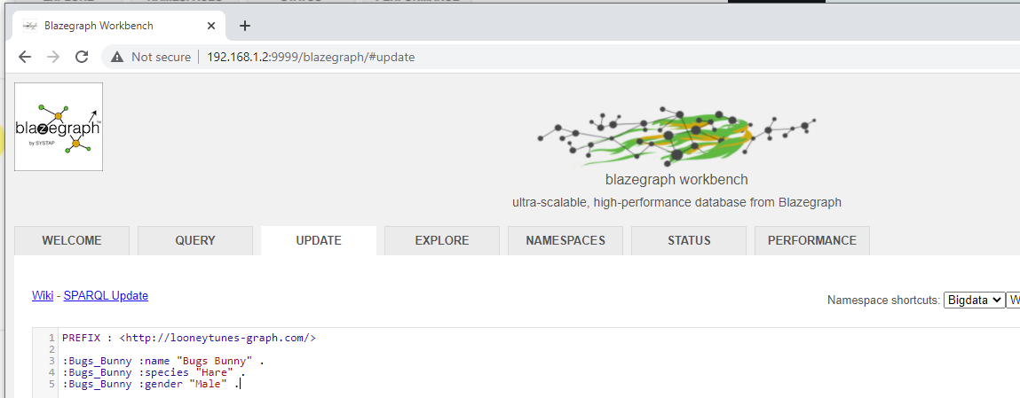
Default IRI and writing RDF triples involving literal values – 7/n

Slide 13
Default IRI and writing RDF triples involving literal values – 8/n

Slide 14
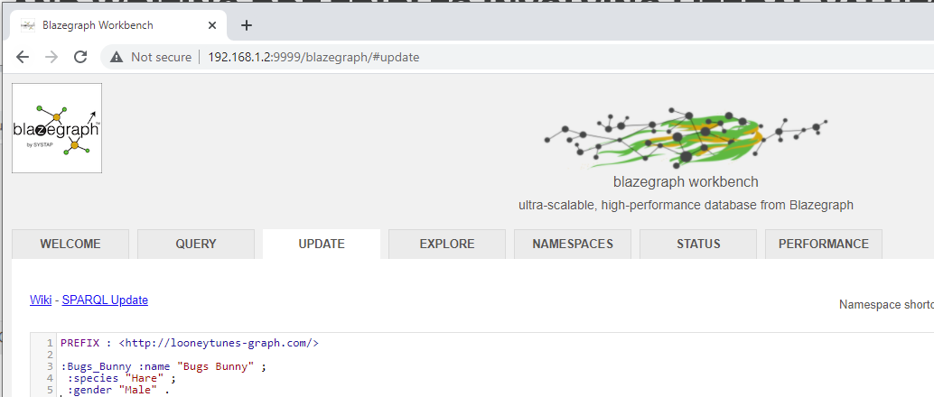
Default IRI and writing RDF triples involving literal values – 9/n

Slide 15
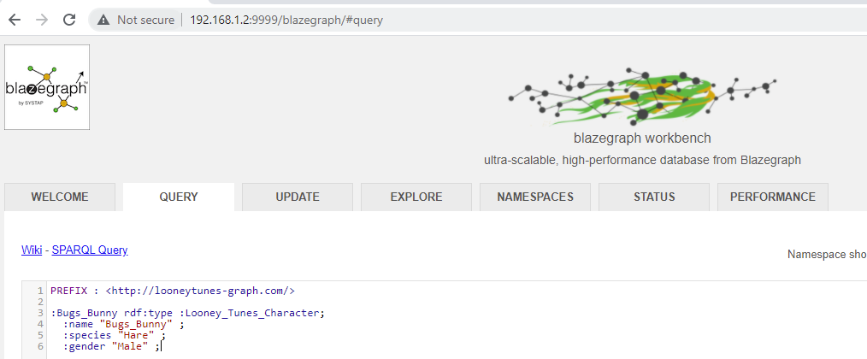
Writing types involving rdF type – 1/n
Basics construct for capturing categories or grouping of things.
Notes:
PREFIX : <http://looneytunes-graph.com/>
:Bugs_Bunny rdf:type :Looney_Tunes_Character;
:name "Bugs_Bunny" ;
:species "Hare" ;
:gender "Male" ;

Slide 16
Writing types involving rdF type – 2/N
Notes:
PREFIX : <http://looneytunes-graph.com/>
:Bugs_Bunny rdf:type :Looney_Tunes_Character;
:name "Bugs_Bunny" ;
:species "Hare" ;
:gender "Male" ;

Slide 17
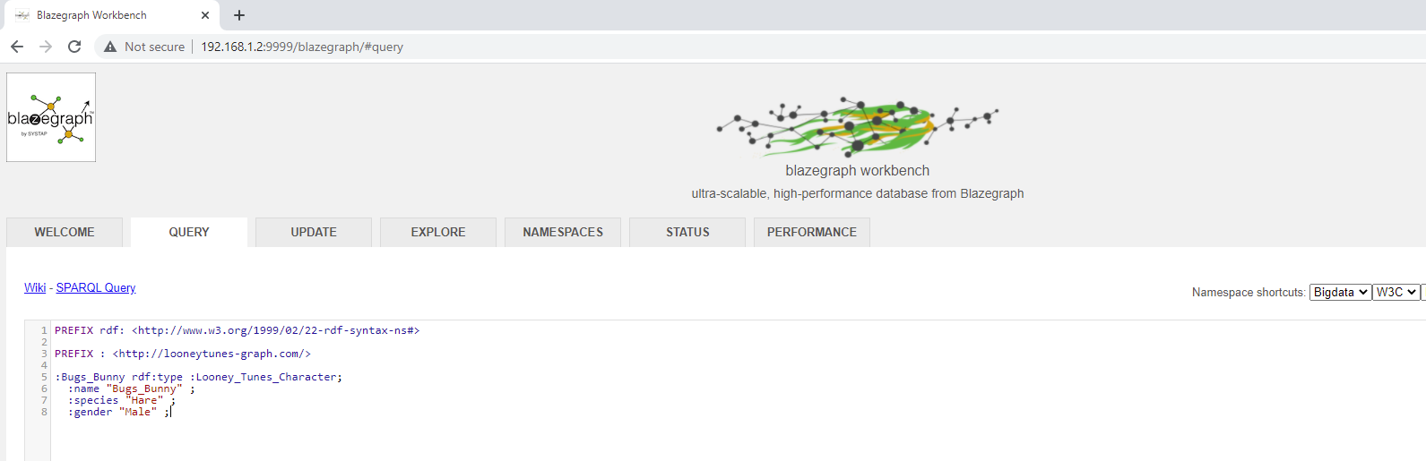
Writing types involving rdF type – 4/N
Notes:
PREFIX : <http://looneytunes-graph.com/>
:Bugs_Bunny rdf:type :Looney_Tunes_Character;
:name "Bugs_Bunny" ;
:species "Hare" ;
:gender "Male" ;

Slide 18
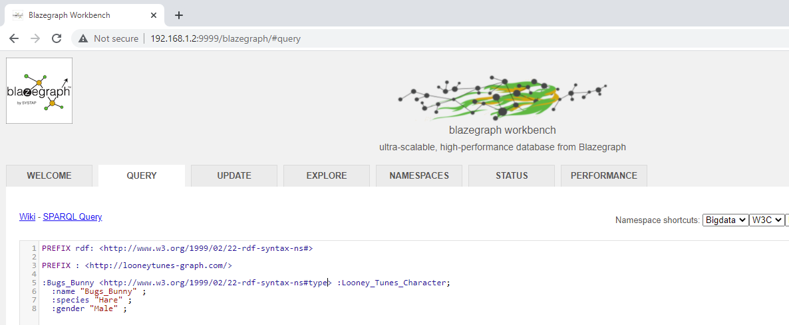
Writing types involving rdF type – 5/N
Notes:
PREFIX : <http://looneytunes-graph.com/>
:Bugs_Bunny rdf:type :Looney_Tunes_Character;
:name "Bugs_Bunny" ;
:species "Hare" ;
:gender "Male" ;

Slide 19
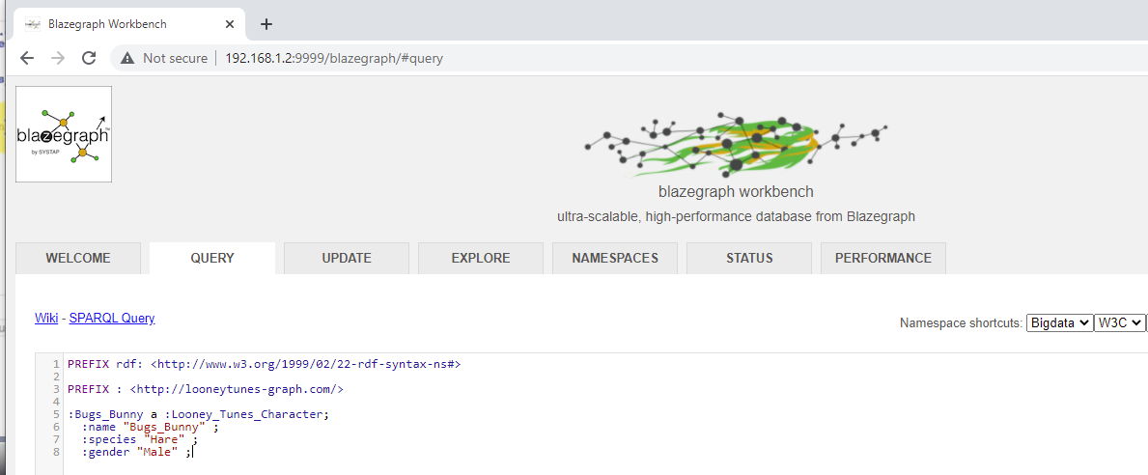
Writing types involving rdF type – 6/N
a is a short type for rsd:type
Notes:
PREFIX : <http://looneytunes-graph.com/>
:Bugs_Bunny rdf:type :Looney_Tunes_Character;
:name "Bugs_Bunny" ;
:species "Hare" ;
:gender "Male" ;

Slide 20
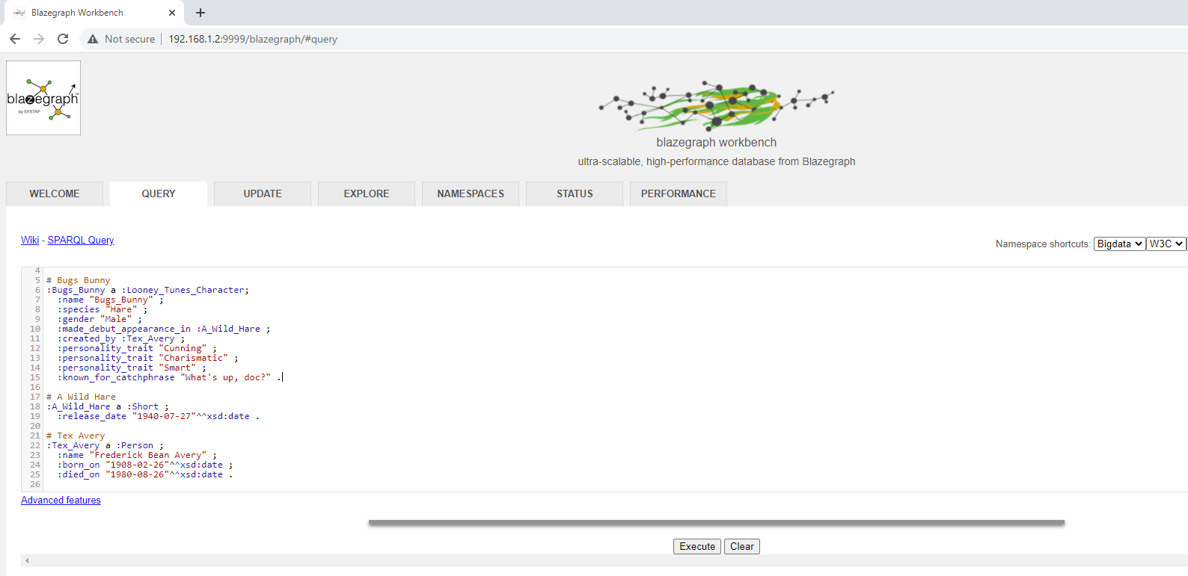
Completing rdf triples – 1/n
Notes:
PREFIX xsd: <http://www.w3.org/2001/XMLSchema#>
PREFIX rdf: <http://www.w3.org/1999/02/22-rdf-syntax-ns#>
PREFIX : <http://looneytunes-graph.com/>
# Bugs Bunny
:Bugs_Bunny a :Looney_Tunes_Character;
:name "Bugs_Bunny" ;
:species "Hare" ;
:gender "Male" ;
:made_debut_appearance_in :A_Wild_Hare ;
:created_by :Tex_Avery ;
:personality_trait "Cunning" ;
:personality_trait "Charismatic" ;
:personality_trait "Smart" ;
:known_for_catchphrase "What's up, doc?" .
# A Wild Hare
:A_Wild_Hare a :Short ;
:release_date "1940-07-27"^^xsd:date .
# Tex Avery
:Tex_Avery a :Person ;
:name "Frederick Bean Avery" ;
:born_on "1908-02-26"^^xsd:date ;
:died_on "1980-08-26"^^xsd:date .

Slide 21
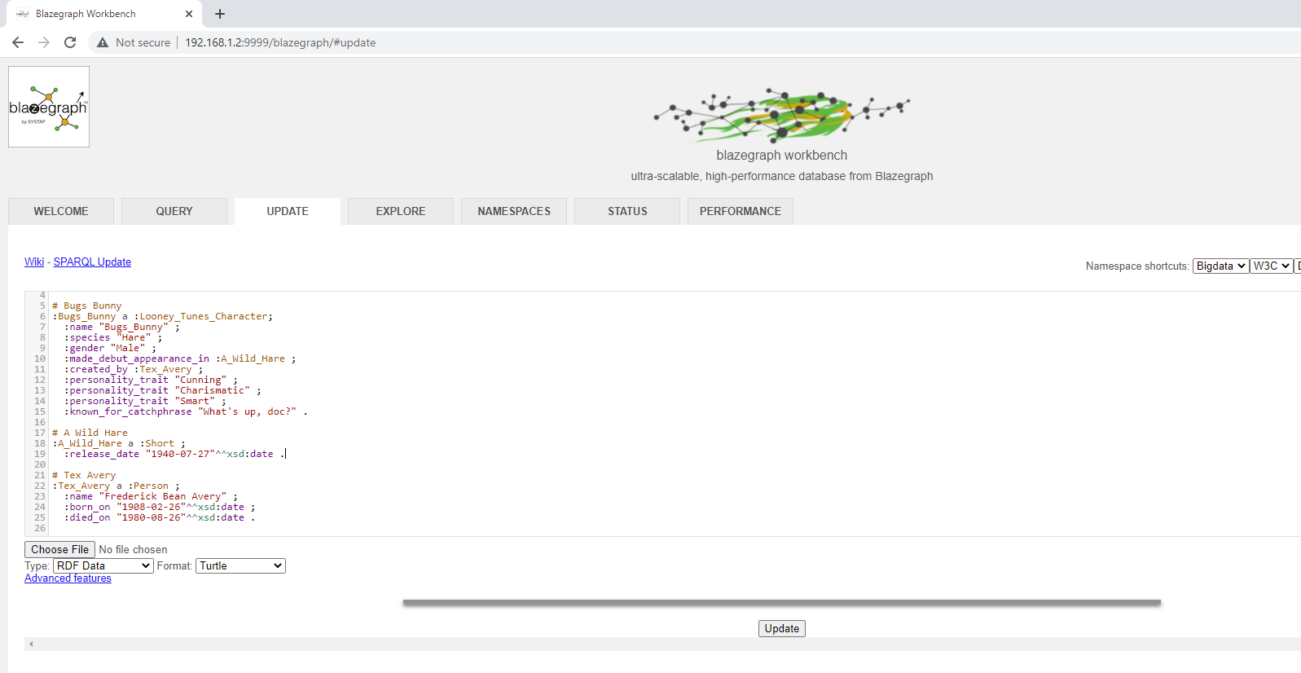
Turtle
RDF Serialization formats.
Notes:
PREFIX xsd: <http://www.w3.org/2001/XMLSchema#>
PREFIX rdf: <http://www.w3.org/1999/02/22-rdf-syntax-ns#>
PREFIX : <http://looneytunes-graph.com/>
# Bugs Bunny
:Bugs_Bunny a :Looney_Tunes_Character;
:name "Bugs_Bunny" ;
:species "Hare" ;
:gender "Male" ;
:made_debut_appearance_in :A_Wild_Hare ;
:created_by :Tex_Avery ;
:personality_trait "Cunning" ;
:personality_trait "Charismatic" ;
:personality_trait "Smart" ;
:known_for_catchphrase "What's up, doc?" .
# A Wild Hare
:A_Wild_Hare a :Short ;
:release_date "1940-07-27"^^xsd:date .
# Tex Avery
:Tex_Avery a :Person ;
:name "Frederick Bean Avery" ;
:born_on "1908-02-26"^^xsd:date ;
:died_on "1980-08-26"^^xsd:date .

Slide 22
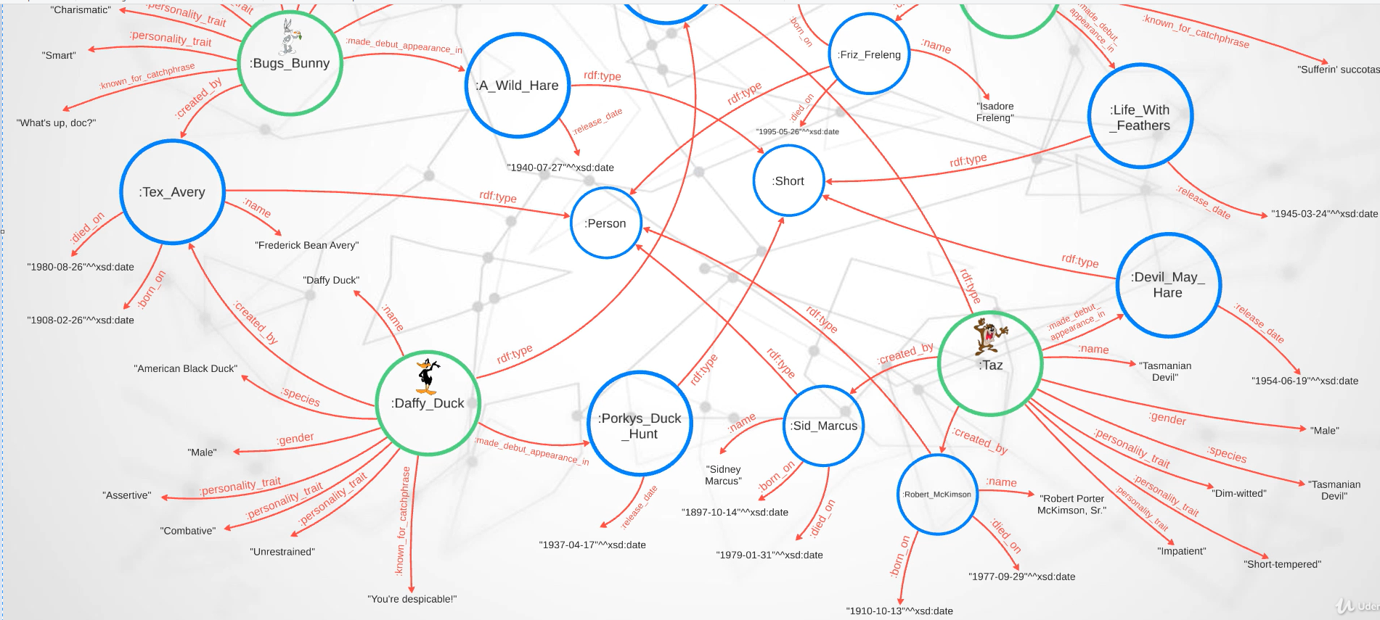
RDF Triples

Slide 23
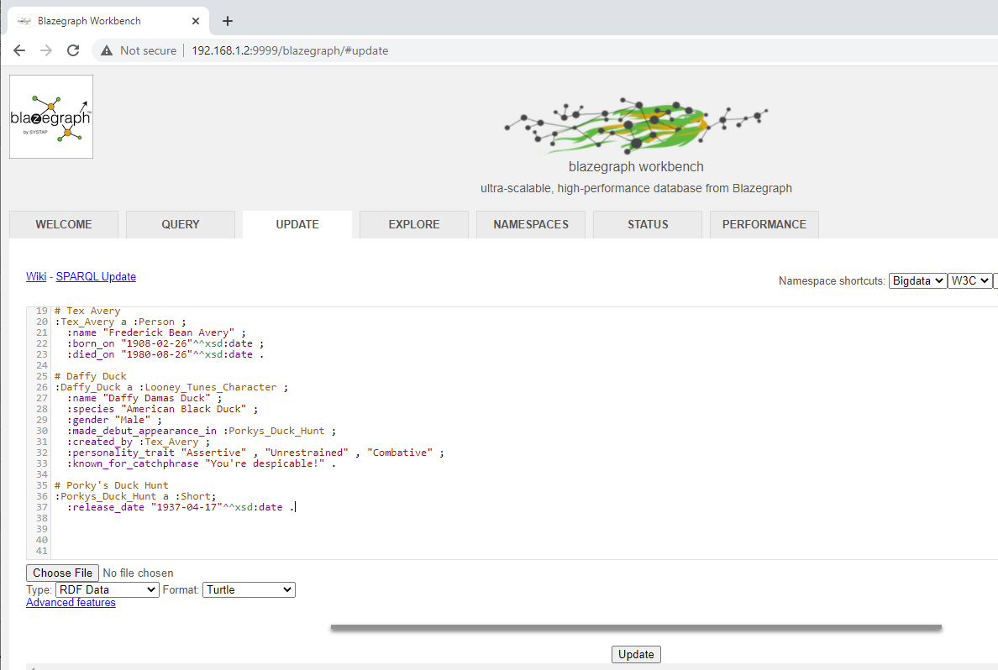
RDF Triples

Slide 24
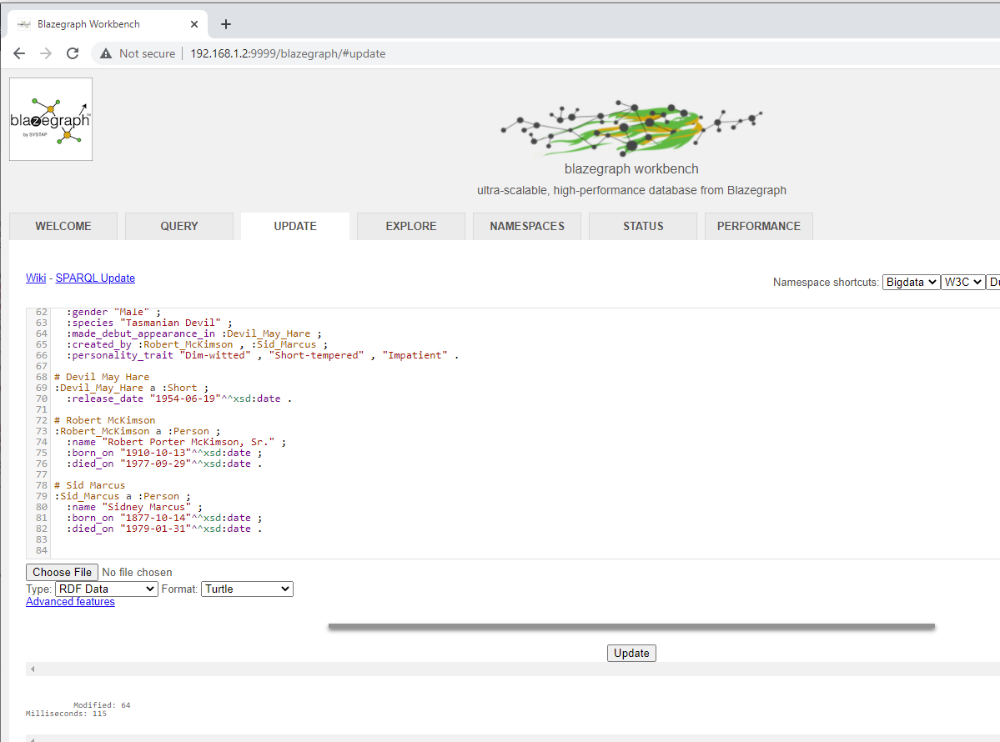
RDF Database
Modified with 64 triples
Notes:
PREFIX : <http://looneytunes-graph.com/>PREFIX rdf: <http://www.w3.org/1999/02/22-rdf-syntax-ns#>PREFIX xsd: <http://www.w3.org/2001/XMLSchema#># Bugs Bunny:Bugs_Bunny a :Looney_Tunes_Character ; :name "Bugs Bunny" ; :species "Hare" ; :gender "Male" ; :made_debut_appearance_in :A_Wild_Hare ; :created_by :Tex_Avery ; :personality_trait "Cunning" , "Charismatic" , "Smart" ; :known_for_catchphrase "What's up, doc?" .# A Wild Hare:A_Wild_Hare a :Short ; :release_date "1940-07-27"^^xsd:date .# Tex Avery:Tex_Avery a :Person ; :name "Frederick Bean Avery" ; :born_on "1908-02-26"^^xsd:date ; :died_on "1980-08-26"^^xsd:date . # Daffy Duck:Daffy_Duck a :Looney_Tunes_Character ; :name "Daffy Damas Duck" ; :species "American Black Duck" ; :gender "Male" ; :made_debut_appearance_in :Porkys_Duck_Hunt ; :created_by :Tex_Avery ; :personality_trait "Assertive" , "Unrestrained" , "Combative" ; :known_for_catchphrase "You're despicable!" .# Porky's Duck Hunt:Porkys_Duck_Hunt a :Short ; :release_date "1937-04-17"^^xsd:date .# Sylvester :Sylvester a :Looney_Tunes_Character ; :name "Sylvester James Pussycat, Sr." ; :species "Tuxedo Cat" ; :gender "Male" ; :made_debut_appearance_in :Life_With_Feathers ; :created_by :Friz_Freleng ; :personality_trait "Proud" , "Persistent" , "Loser" ; :known_for_catchphrase "Sufferin' Succotash" .# Life With Feathers:Life_With_Feathers a :Short ; :release_date "1945-03-24"^^xsd:date .# Friz Frelang:Friz_Freleng a :Person ; :name "Isadore Freleng" ; :born_on "1905-08-21"^^xsd:date ; :died_on "1995-05-26"^^xsd:date .# Taz:Taz a :Looney_Tunes_Character ; :name "Tasmanian Devil" ; :gender "Male" ; :species "Tasmanian Devil" ; :made_debut_appearance_in :Devil_May_Hare ; :created_by :Robert_McKimson , :Sid_Marcus ; :personality_trait "Dim-witted" , "Short-tempered" , "Impatient" .# Devil May Hare:Devil_May_Hare a :Short ; :release_date "1954-06-19"^^xsd:date .# Robert McKimson:Robert_McKimson a :Person ; :name "Robert Porter McKimson, Sr." ; :born_on "1910-10-13"^^xsd:date ; :died_on "1977-09-29"^^xsd:date .# Sid Marcus:Sid_Marcus a :Person ; :name "Sidney Marcus" ; :born_on "1877-10-14"^^xsd:date ; :died_on "1979-01-31"^^xsd:date .

Slide 25

SPARQL 1.1

Slide 26
Basic query pattern
SPARQL is the query language for interrogating with RDF based graph. Also, a standard maintained by W3C.
SELECT clause read and write things from Graph.
* means to select everything.
WHERE clause is for the Graph pattern.
Variables start with a question mark (?) symbol.
?s : Subject , ?p: predicate, ?o: object.

Slide 27
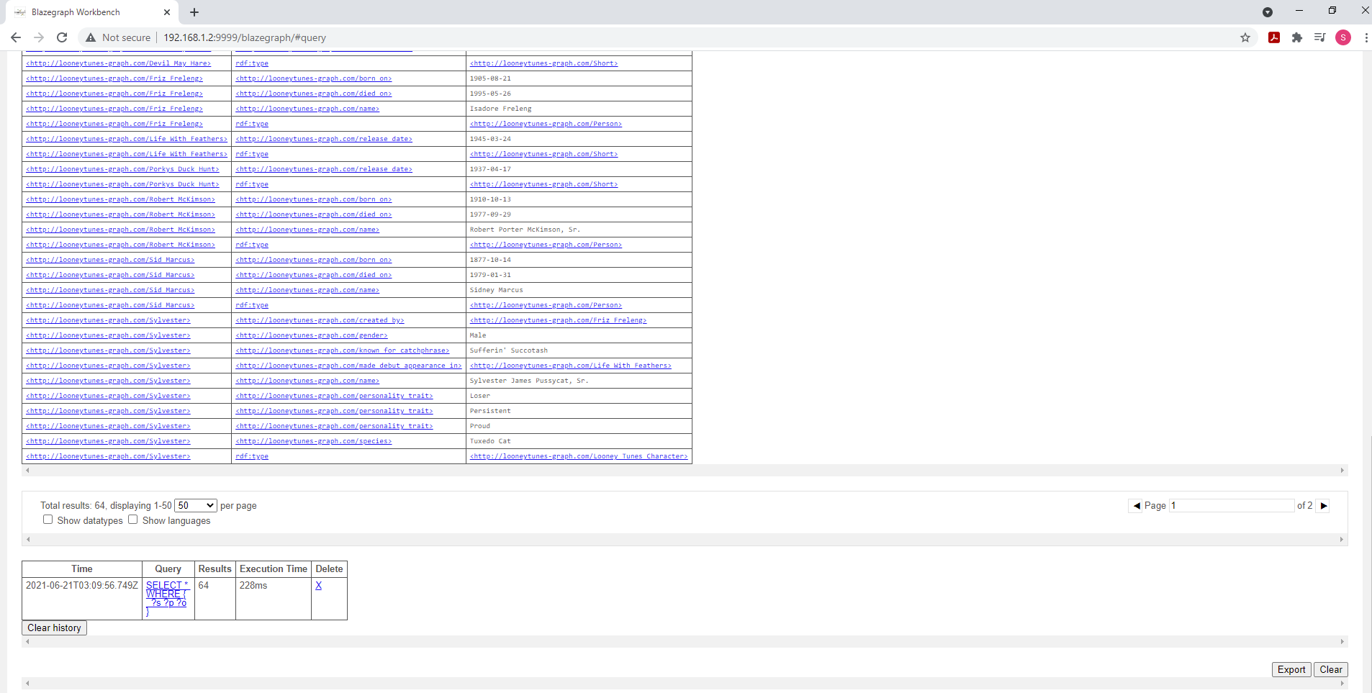
Querying - 1
Notes:
SELECT *
WHERE {
?s ?p ?o
}

Slide 28
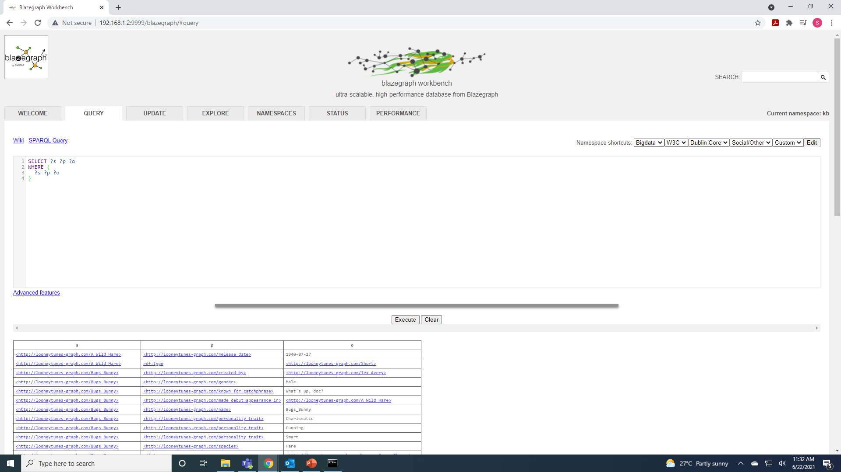
Querying - 2
Not a good idea to run this query for large datasets.
Notes:
SELECT ?s ?p ?o
WHERE {
?s ?p ?o
}

Slide 29
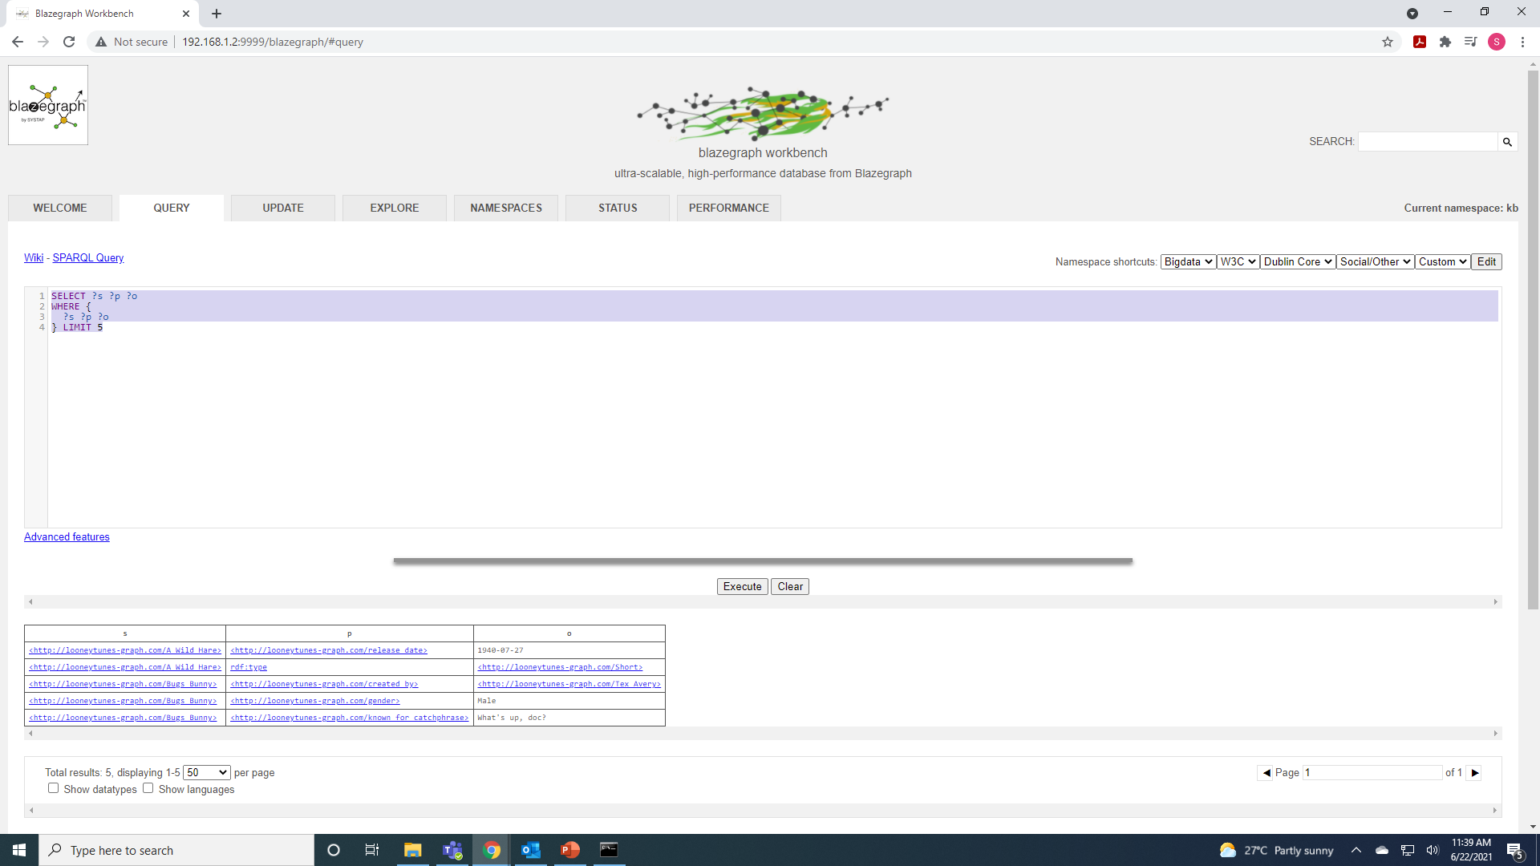
Querying - 3
Effective way of grabbing a sample of data.
Notes:
SELECT ?s ?p ?o
WHERE {
?s ?p ?o
} LIMIT 5

Slide 30
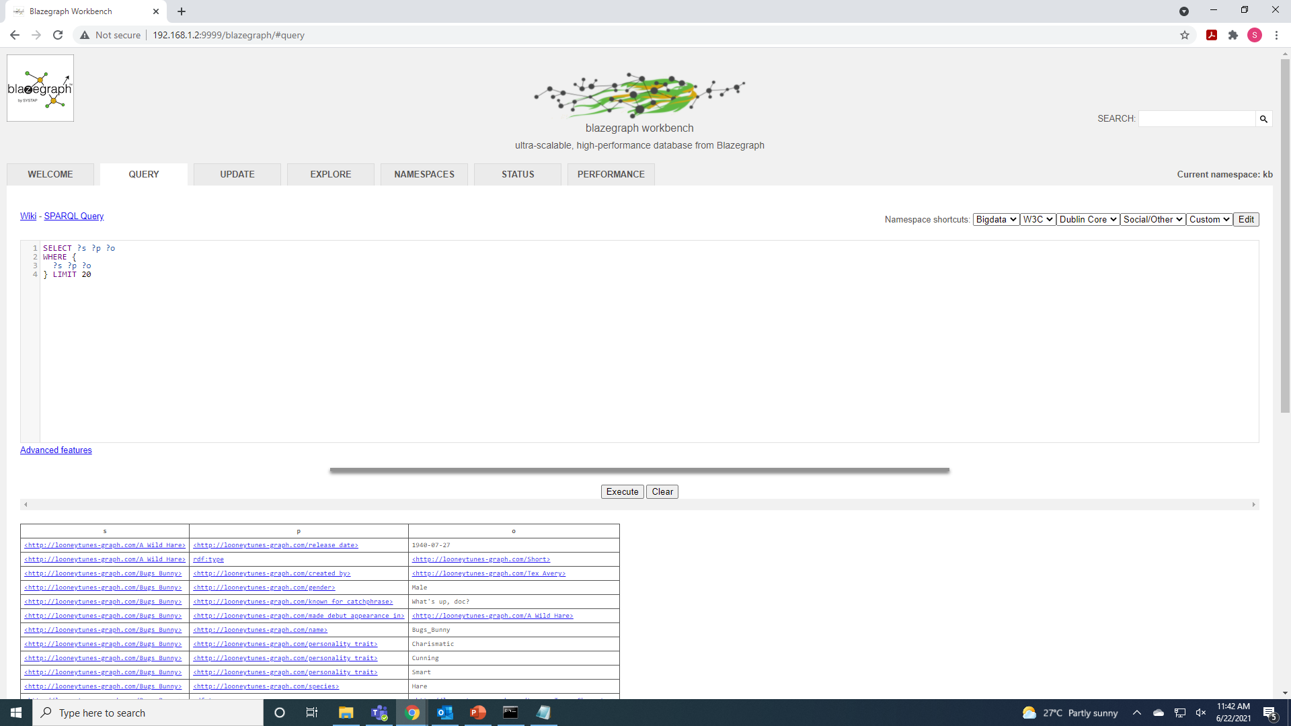
Activity
[Activity] Basic graph pattern
In the Query tab in Blazegraph, compose and run a SPARQL query that displays a sample of 20 triples using the basic graph pattern explained in the previous two lectures.
Notes:
SELECT ?s ?p ?o
WHERE {
?s ?p ?o
} LIMIT 20

Slide 31
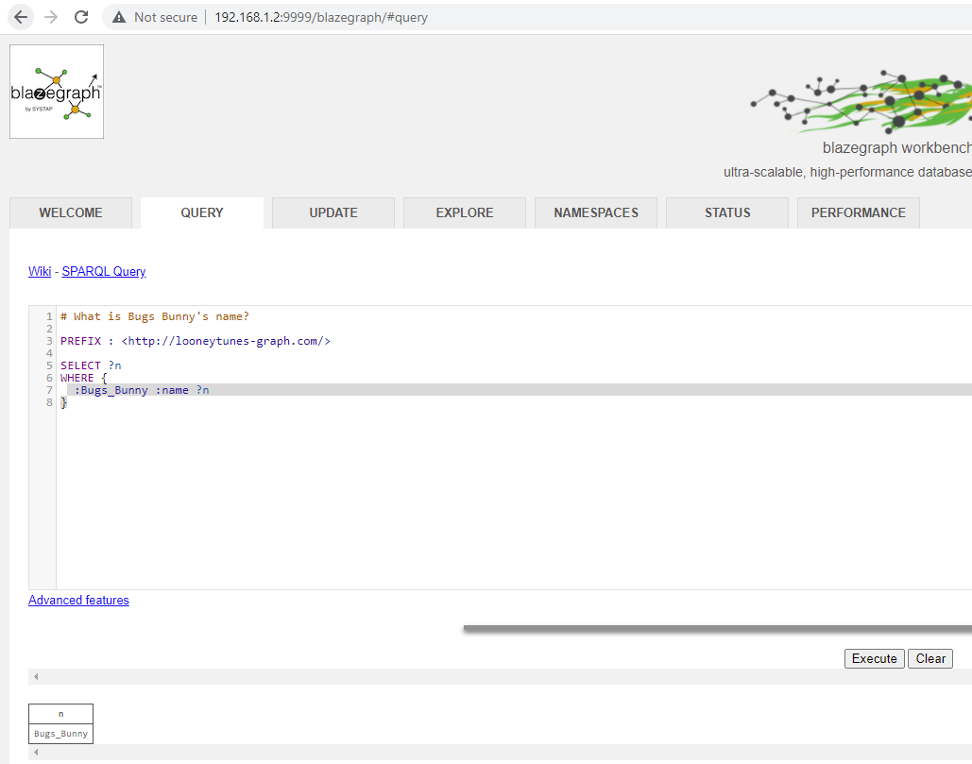
Hop Away Query - 1
Notes:
# What is Bugs Bunny's name?
PREFIX : <http://looneytunes-graph.com/>
SELECT ?c
WHERE {
:Bugs_Bunny :created_by ?c
}

Slide 32
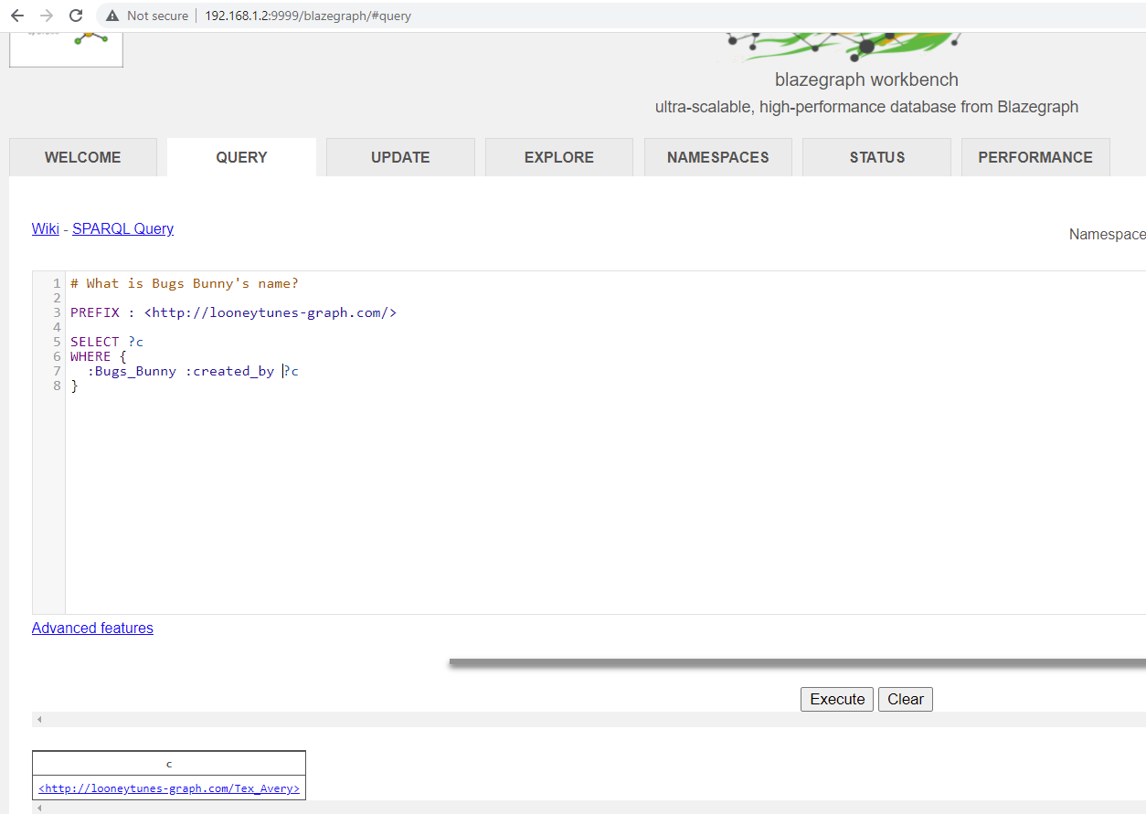
Hop Away Query - 2
Notes:
# What is Bugs Bunny's name?
PREFIX : <http://looneytunes-graph.com/>
SELECT ?c
WHERE {
:Bugs_Bunny :created_by ?c
}

Slide 33
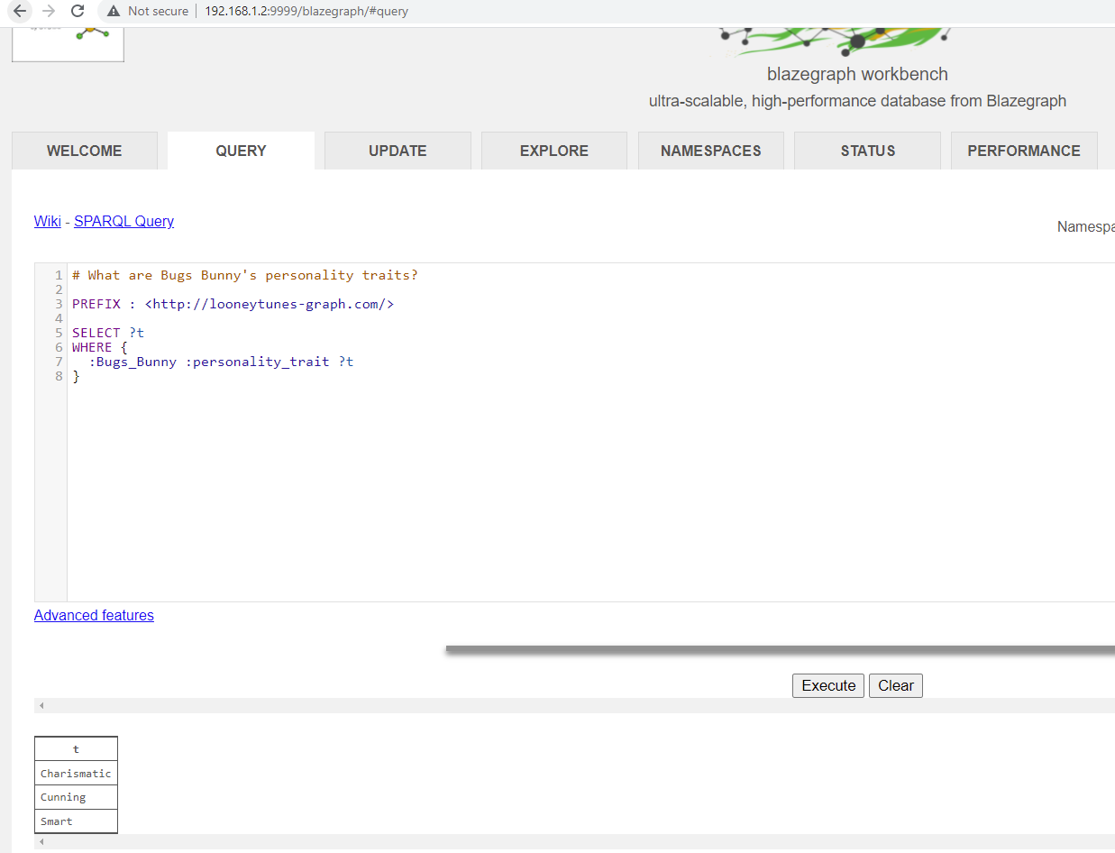
Hop Away Query - 3
Notes:
# What are Bugs Bunny's personality traits?
PREFIX : <http://looneytunes-graph.com/>
SELECT ?t
WHERE {
:Bugs_Bunny :personality_trait ?t
}

Slide 34
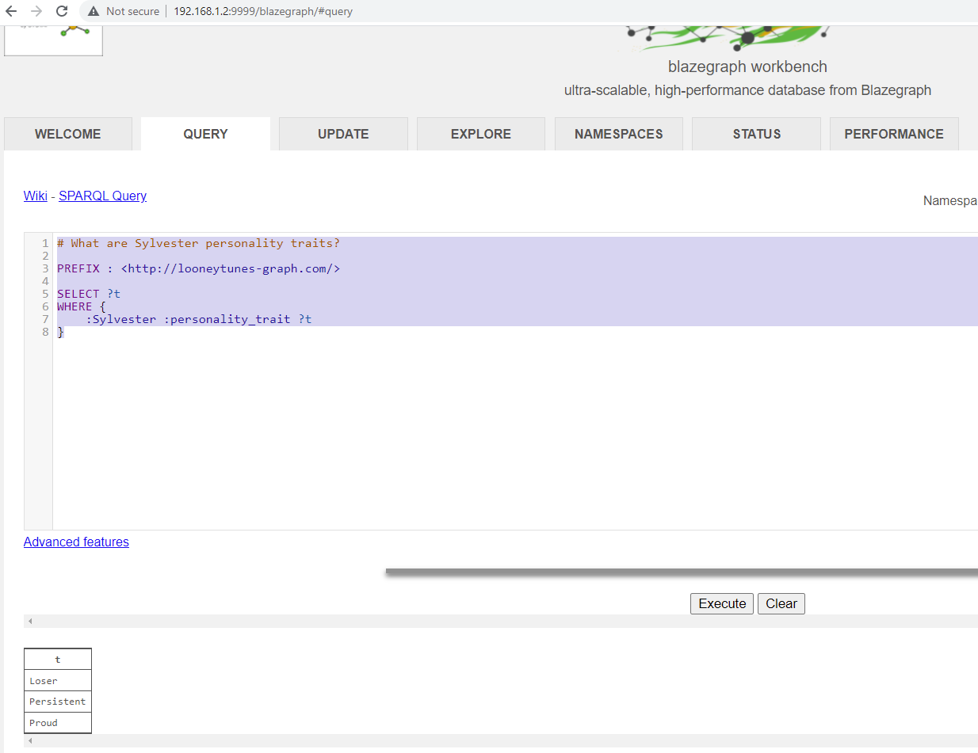
Hop Away Query - 4
Notes:
# What are Sylvester personality traits?
PREFIX : <http://looneytunes-graph.com/>
SELECT ?t
WHERE {
:Sylvester :personality_trait ?t
}

Slide 35
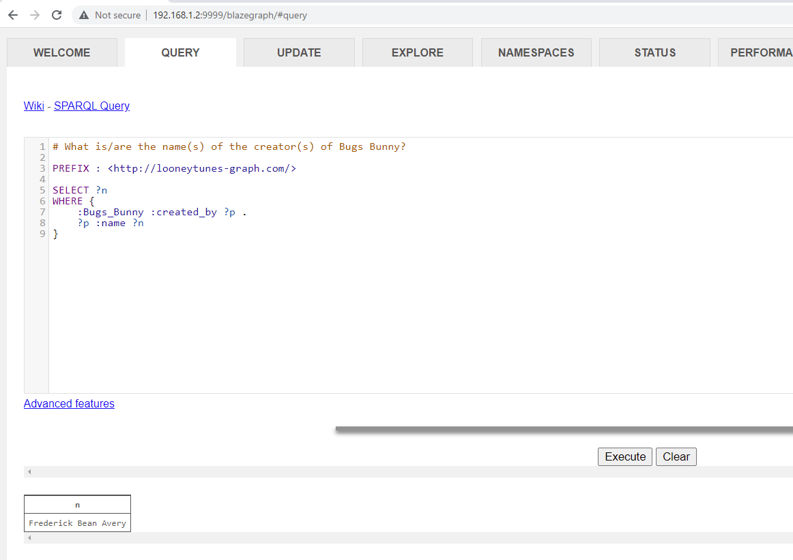
TWO HOPS Query - 1
Dot (.) means ‘AND’ (i,e conjunction)
Notes:
# What is/are the name(s) of the creator(s) of Bugs Bunny?
PREFIX : <http://looneytunes-graph.com/>
SELECT ?n
WHERE {
:Bugs_Bunny :created_by ?p .
?p :name ?n
}

Slide 36
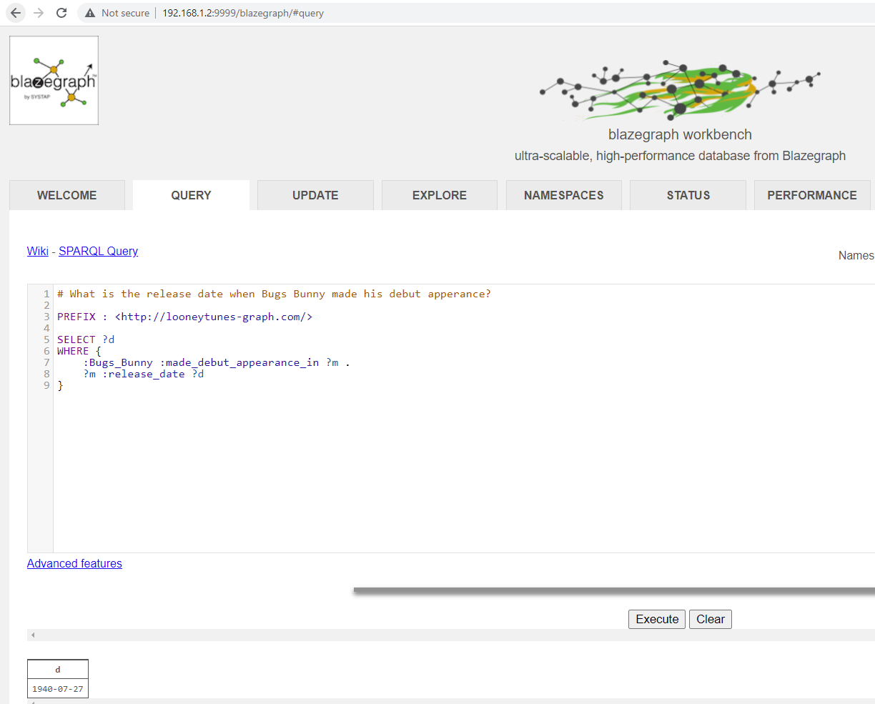
TWO HOPS Query - 2
Notes:
# What is the release date when Bugs Bunny made his debut apperance?
PREFIX : <http://looneytunes-graph.com/>
SELECT ?d
WHERE {
:Bugs_Bunny :made_debut_appearance_in ?m .
?m :release_date ?d
}

Slide 37
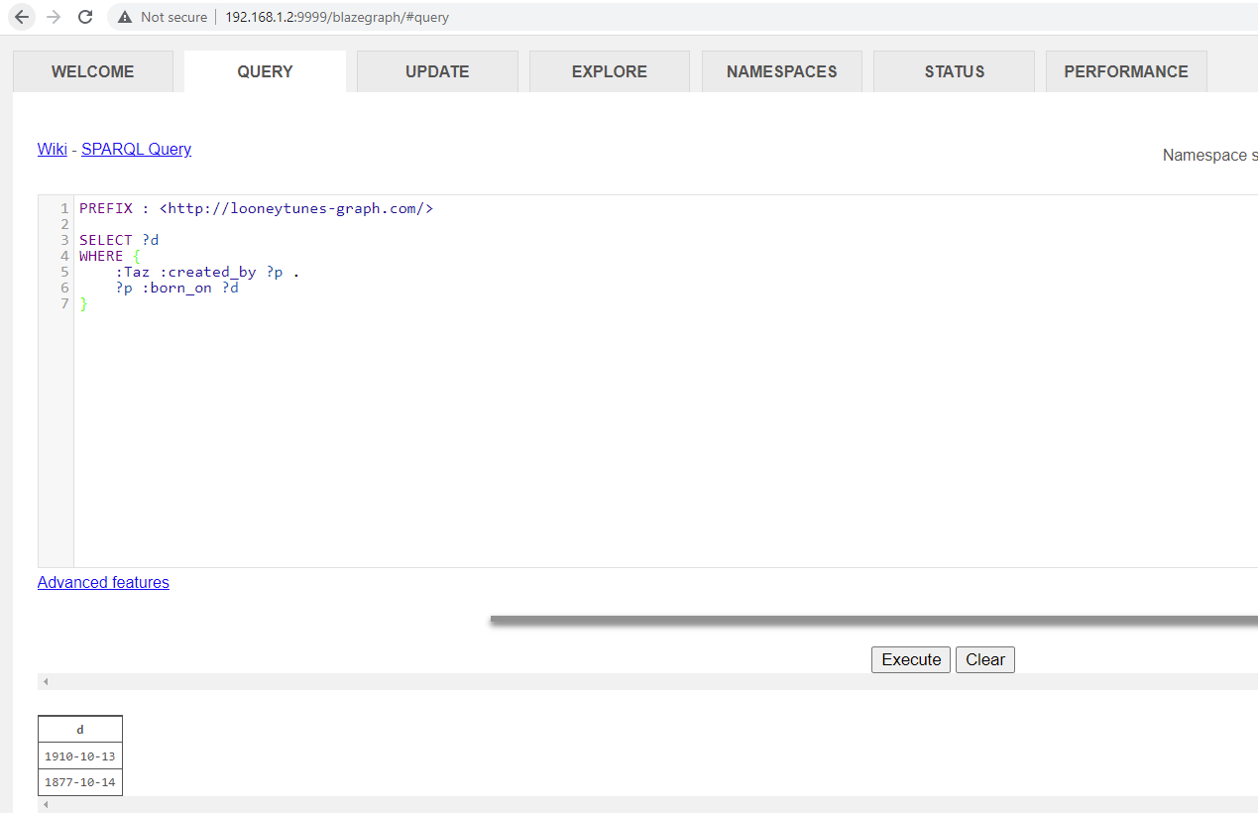
TWO HOPS Query - 3
Compose and run a SPARQL query to list the birth dates of the creators of Taz. For this activity, we are just after the birth dates only.
Notes:
PREFIX : <http://looneytunes-graph.com/>
SELECT ?d
WHERE {
:Taz :created_by ?p .
?p :born_on ?d
}

Slide 38
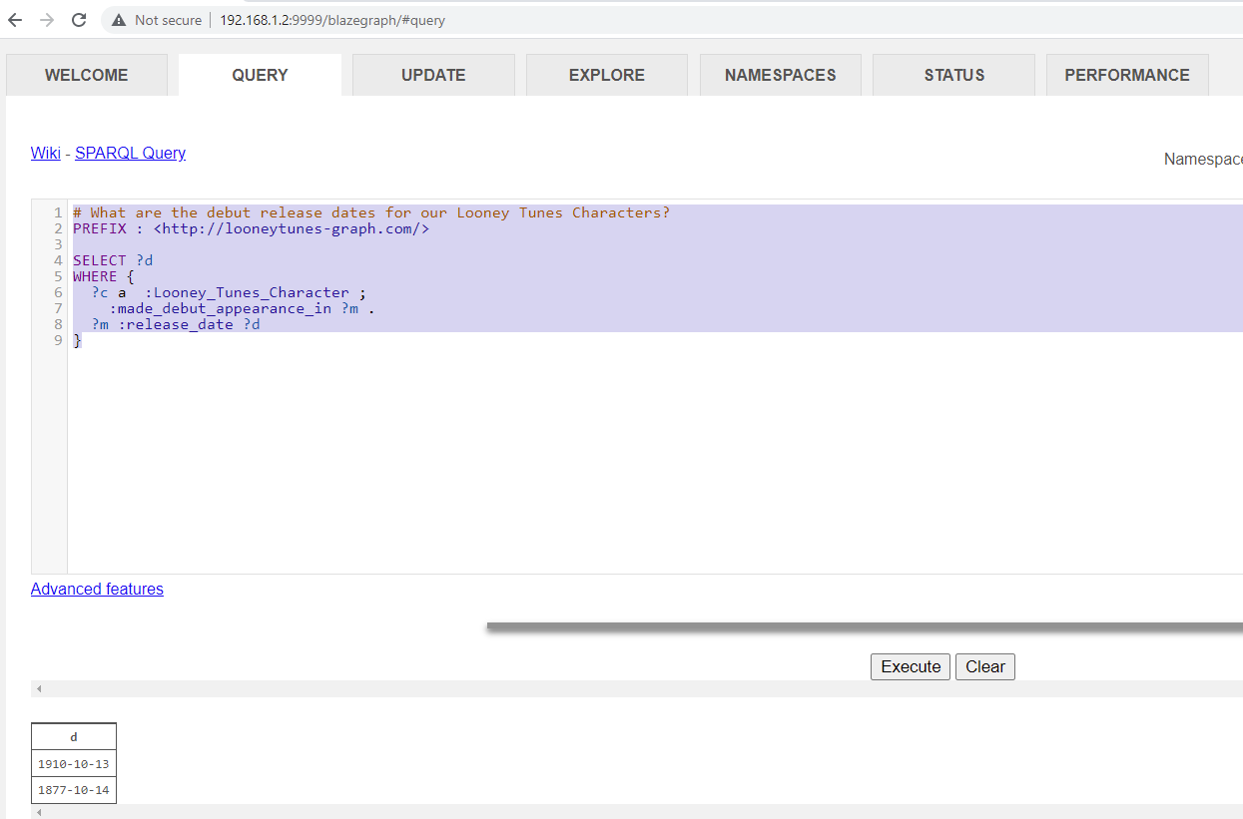
Writing lean queries - 1
‘a’ is short for rdf:type
Notes:
# What are the debut release dates for our Looney Tunes Characters?
PREFIX : <http://looneytunes-graph.com/>
SELECT ?d
WHERE {
?c a :Looney_Tunes_Character ;
:made_debut_appearance_in ?m .
?m :release_date ?d
}

Slide 39
Writing lean queries - 1
‘a’ is short for rdf:type
Notes:
# What are the debut release dates for our Looney Tunes Characters?
PREFIX : <http://looneytunes-graph.com/>
SELECT ?d
WHERE {
?c a :Looney_Tunes_Character ;
:made_debut_appearance_in ?m .
?m :release_date ?d
}

Slide 40
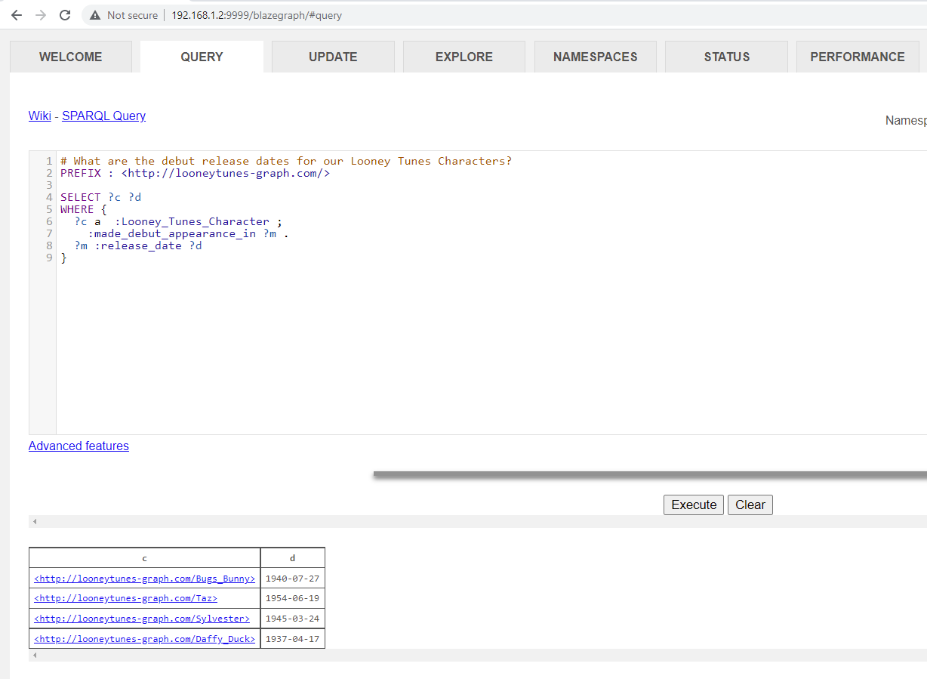
Writing lean queries - 2
‘a’ is short for rdf:type
Notes:
# What are the debut release dates for our Looney Tunes Characters?
PREFIX : <http://looneytunes-graph.com/>
SELECT ?c ?d
WHERE {
?c a :Looney_Tunes_Character ;
:made_debut_appearance_in ?m .
?m :release_date ?d
}

Slide 41
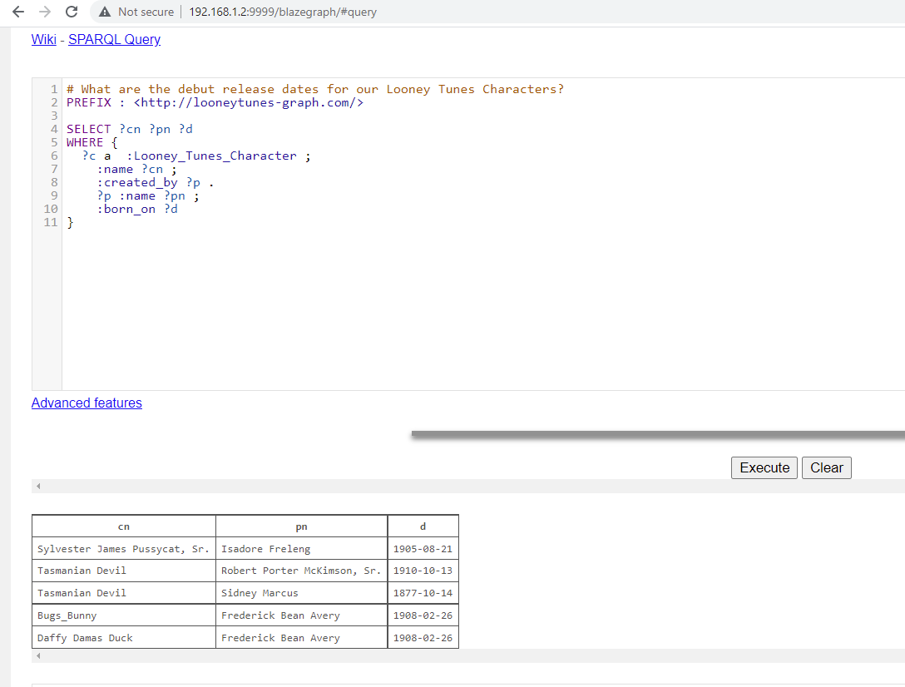
Writing lean queries - 3
‘a’ is short for rdf:type
Notes:
# What are the debut release dates for our Looney Tunes Characters?
PREFIX : <http://looneytunes-graph.com/>
SELECT ?n ?d
WHERE {
?c a :Looney_Tunes_Character ;
:name ?n ;
:made_debut_appearance_in ?m .
?m :release_date ?d
}

Slide 42
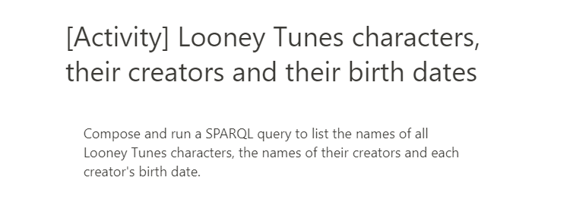
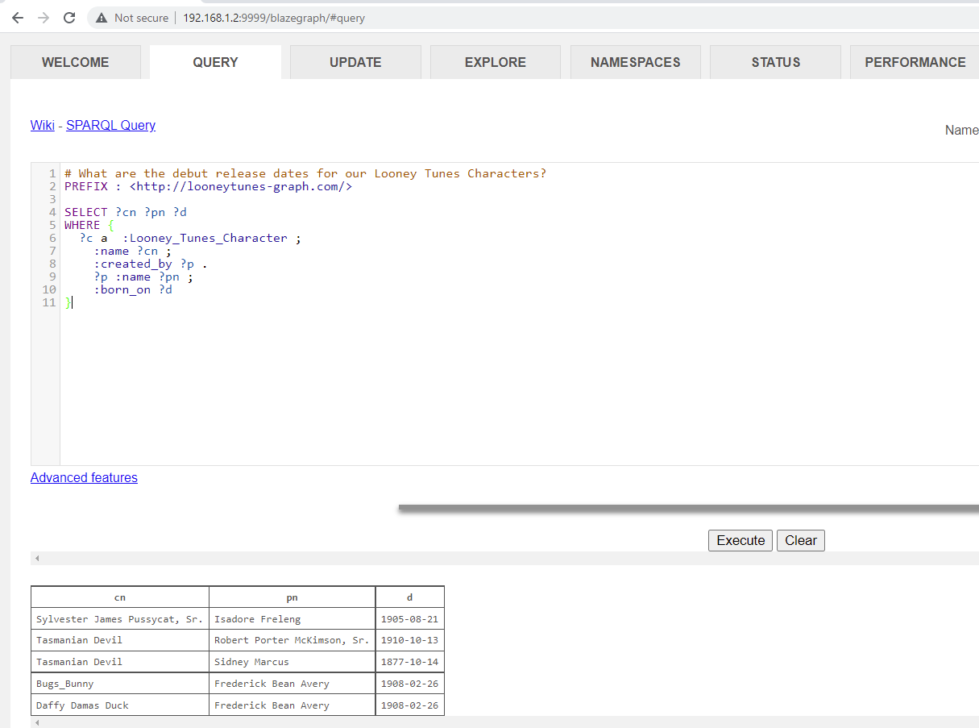
Writing lean queries - 4
Notes:
# What are the debut release dates for our Looney Tunes Characters?
PREFIX : <http://looneytunes-graph.com/>
SELECT ?cn ?pn ?d
WHERE {
?c a :Looney_Tunes_Character ;
:name ?cn ;
:created_by ?p .
?p :name ?pn ;
:born_on ?d
}

Slide 43
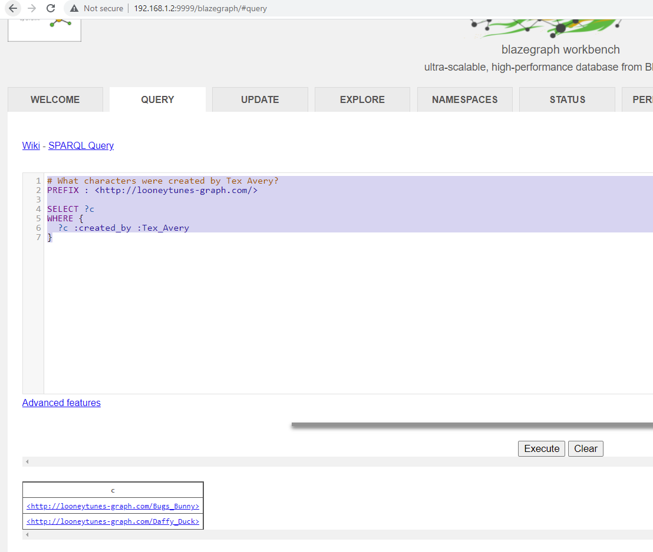
COUNT in the graph - 1
Count is an aggregation function. Other aggregate functions : SUM, AVG, etc.
Notes:
# What characters were created by Tex Avery?
PREFIX : <http://looneytunes-graph.com/>
SELECT ?c
WHERE {
?c :created_by :Tex_Avery
}

Slide 44
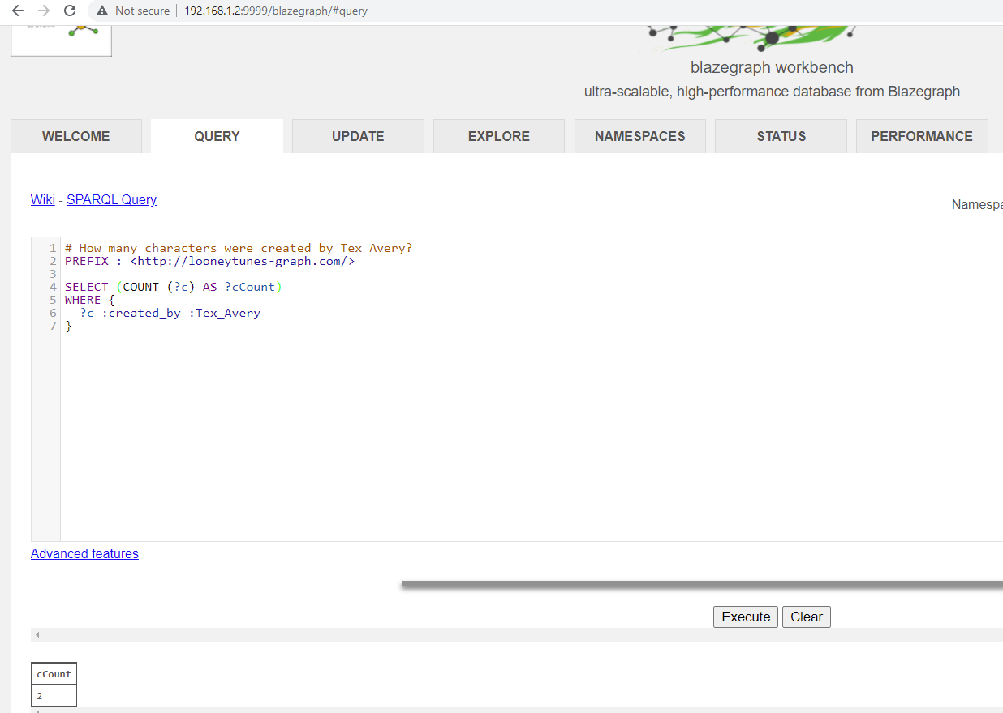
COUNT in the graph - 2
Count is an aggregation function. Other aggregate functions : SUM, AVG, etc.
Notes:
# How many characters were created by Tex Avery?
PREFIX : <http://looneytunes-graph.com/>
SELECT (COUNT (?c) AS ?cCount)
WHERE {
?c :created_by :Tex_Avery
}

Slide 45
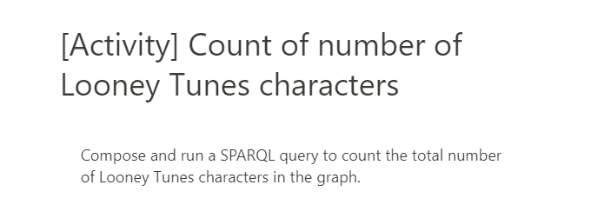
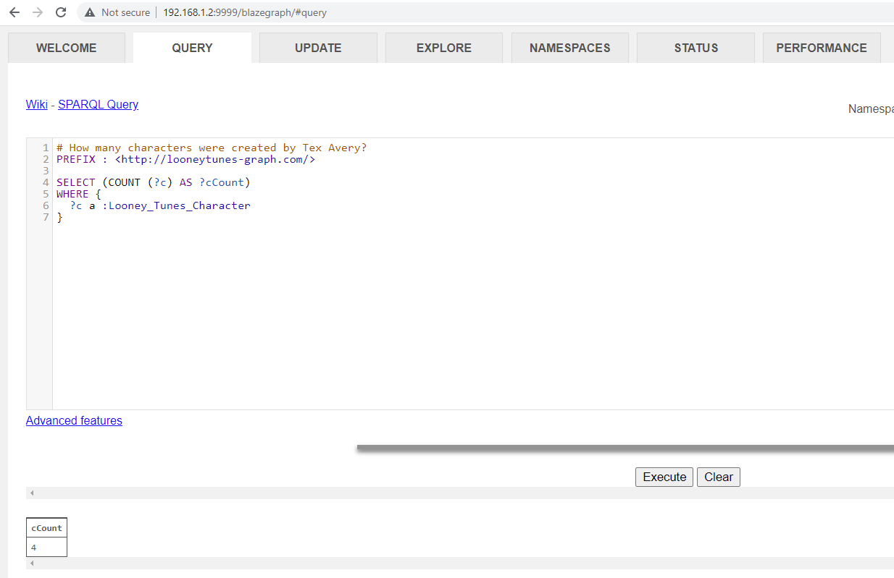
COUNT in the graph - 3
Notes:
# How many characters were created by Tex Avery?
PREFIX : <http://looneytunes-graph.com/>
SELECT (COUNT (?c) AS ?cCount)
WHERE {
?c a :Looney_Tunes_Character
}

Slide 46
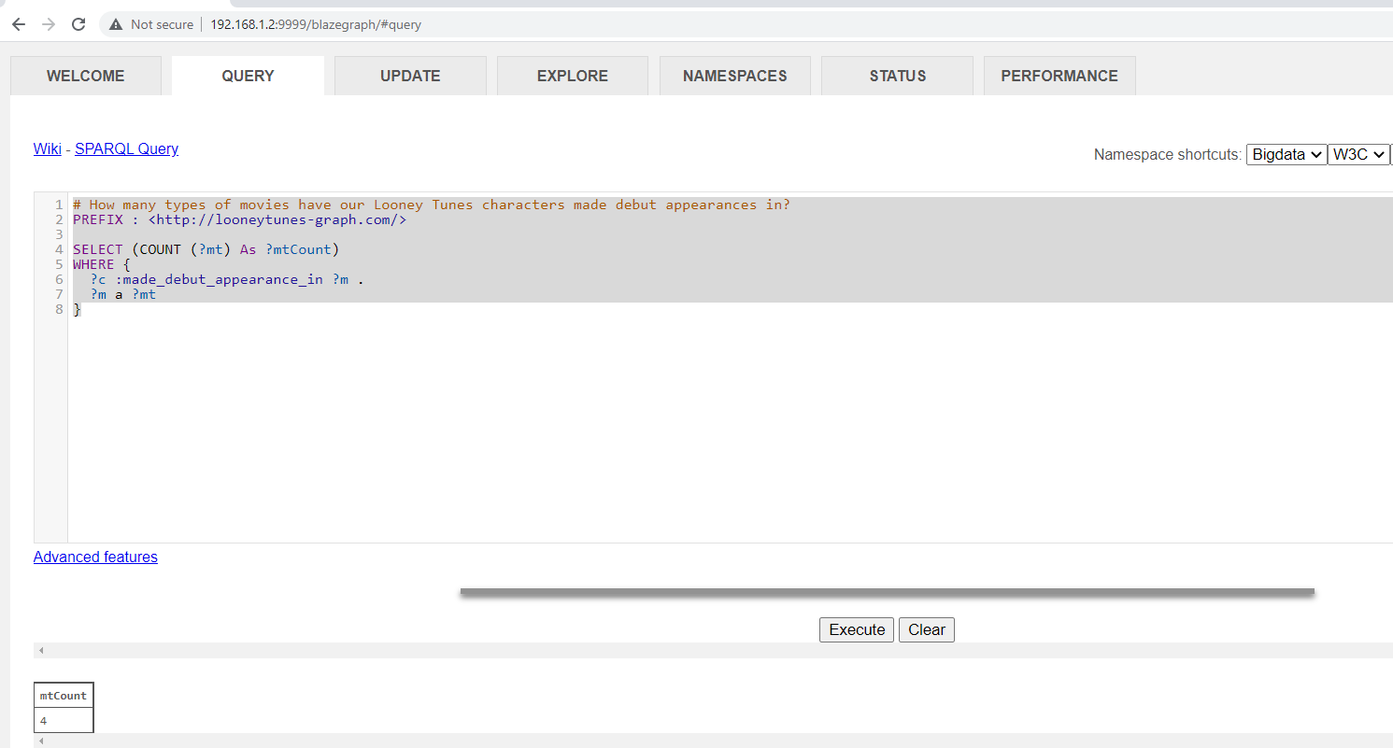
Remove duplicates in query results

Slide 47
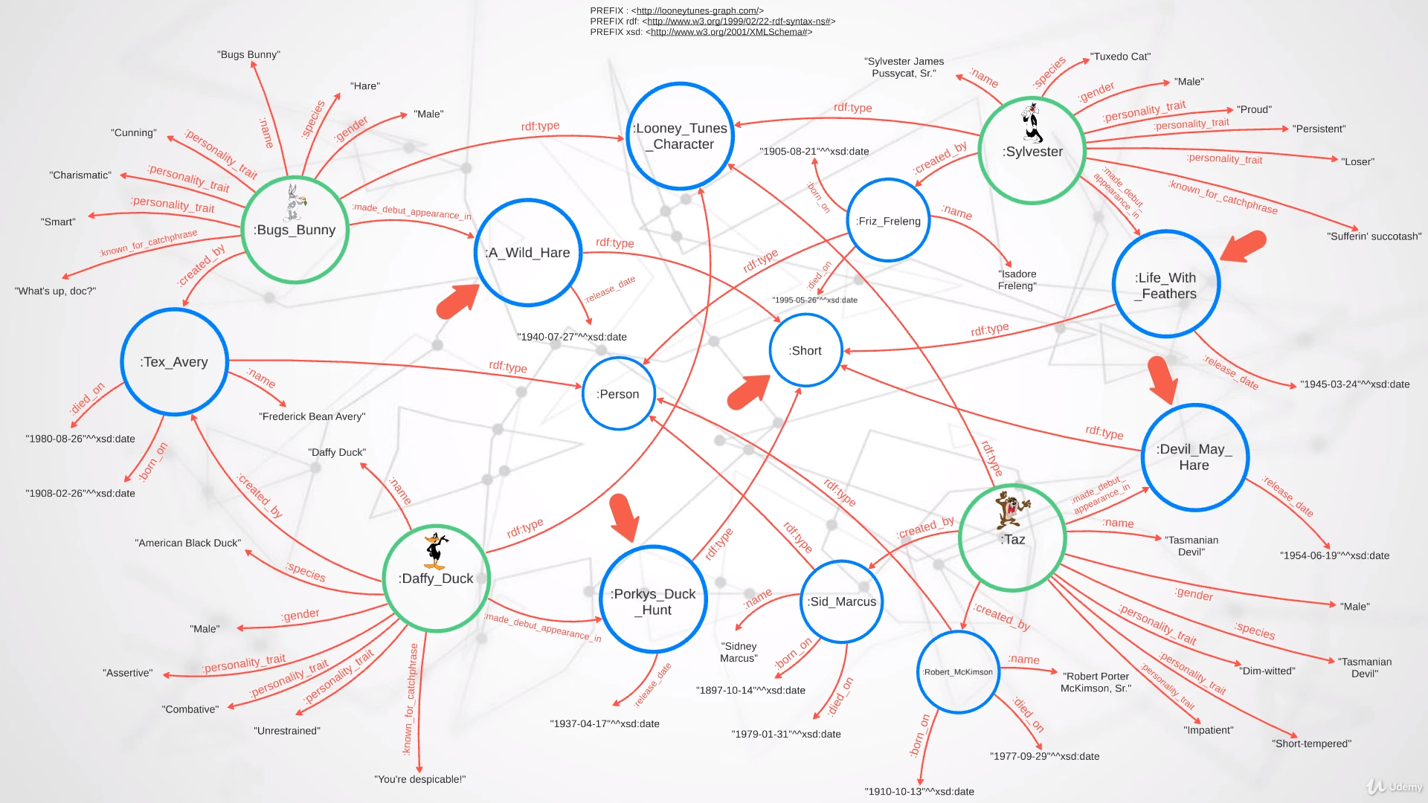

Slide 48
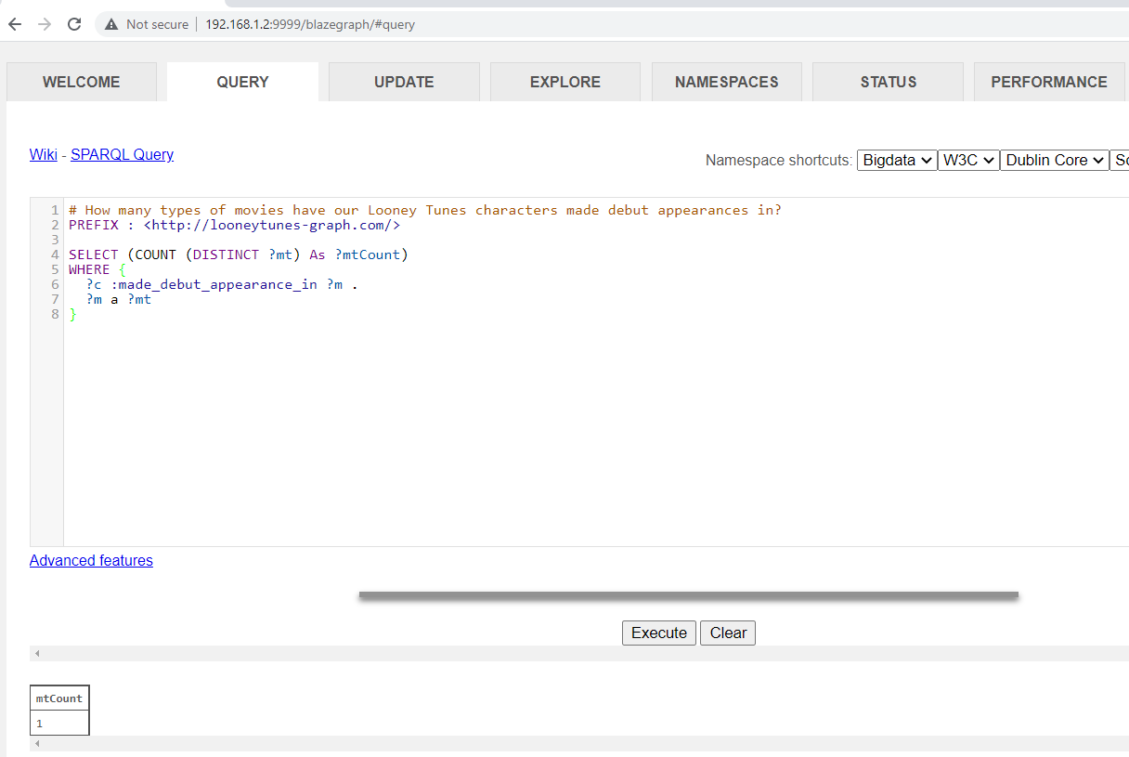
Remove duplicates in query results - DISTINCT
Notes:
# How many types of movies have our Looney Tunes characters made debut appearances in?
PREFIX : <http://looneytunes-graph.com/>
SELECT (COUNT (DISTINCT ?mt) As ?mtCount)
WHERE {
?c :made_debut_appearance_in ?m .
?m a ?mt
}

Slide 49
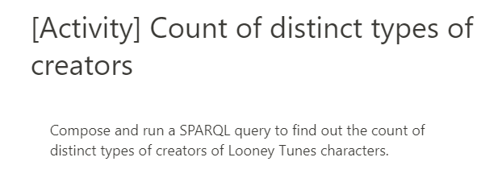
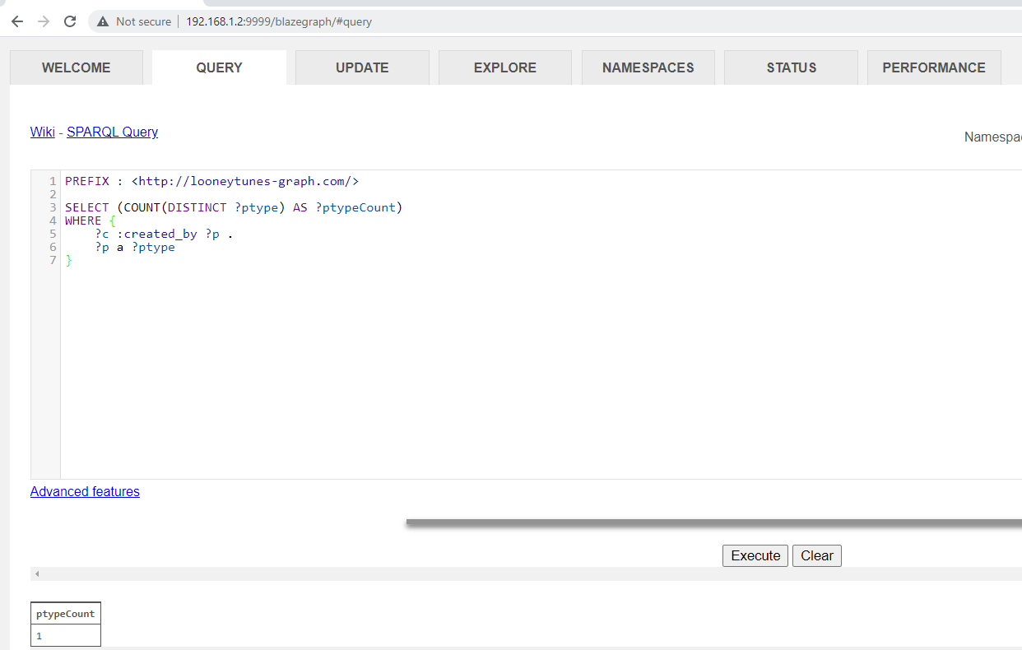
Activity
Notes:
PREFIX : <http://looneytunes-graph.com/>
SELECT (COUNT(DISTINCT ?ptype) AS ?ptypeCount)
WHERE {
?c :created_by ?p .
?p a ?ptype
}

Slide 50
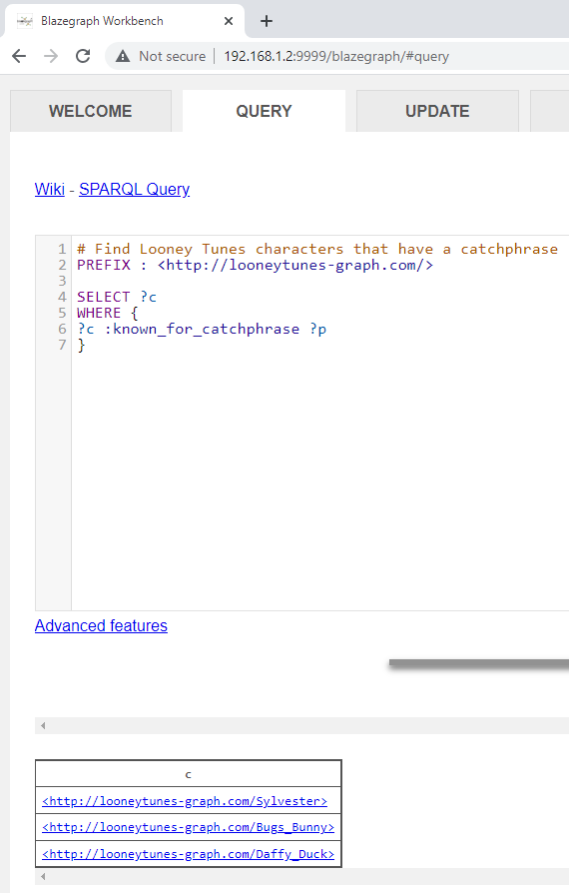
Existence of specific patterns
Check for existence and inexistence.
Notes:
# Find Looney Tunes characters that have a catchphrase
PREFIX : <http://looneytunes-graph.com/>
SELECT ?c
WHERE {
?c :known_for_catchphrase ?p
}

Slide 51
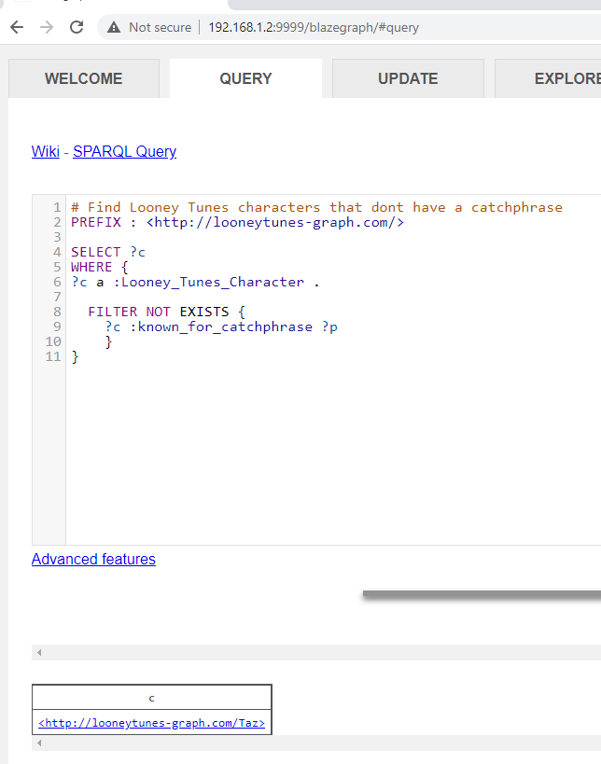
Non-Existence of specific patterns
Check for inexistence.
Notes:
# Find Looney Tunes characters that dont have a catchphrase
PREFIX : <http://looneytunes-graph.com/>
SELECT ?c
WHERE {
?c a :Looney_Tunes_Character .
FILTER NOT EXISTS {
?c :known_for_catchphrase ?p
}
}

Slide 52
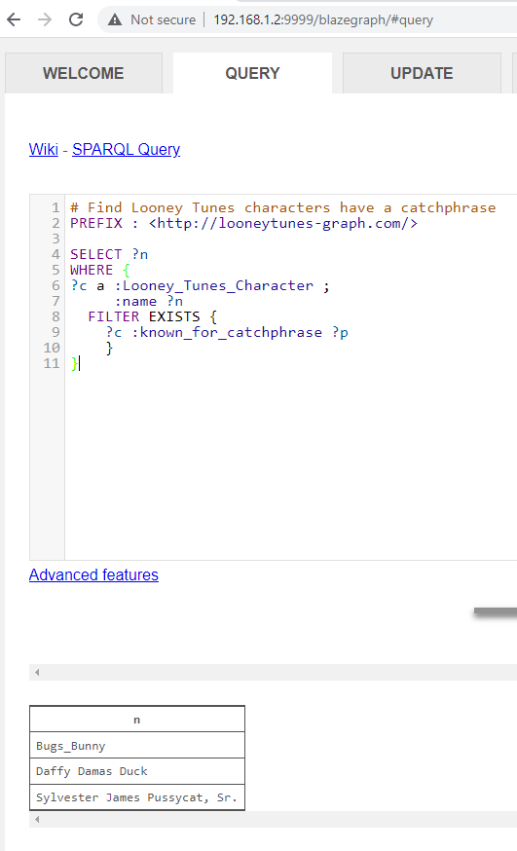
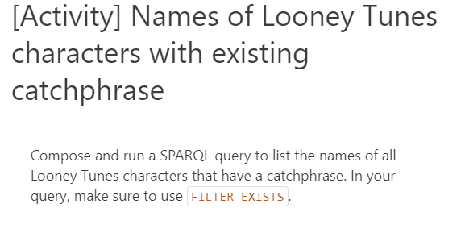
Activity
Notes:
# Find Looney Tunes characters have a catchphrase
PREFIX : <http://looneytunes-graph.com/>
SELECT ?n
WHERE {
?c a :Looney_Tunes_Character ;
:name ?n
FILTER EXISTS {
?c :known_for_catchphrase ?p
}
}

Slide 53
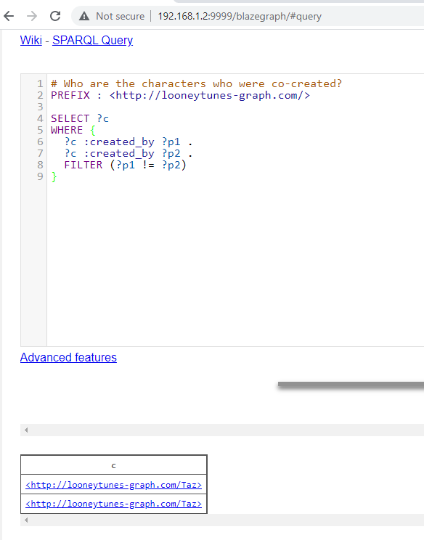
List
More than 1 triple involving “created_by’ predicate, for which objects are different.
SPARQL has several bult-in functions, e.g., comparison, logical & mathematical operators.
Notes:
# Who are the characters who were co-created?
PREFIX : <http://looneytunes-graph.com/>
SELECT ?c
WHERE {
?c :created_by ?p1 .
?c :created_by ?p2 .
FILTER (?p1 != ?p2)
}

Slide 54

List with distinct
Notes:
# Who are the characters who were co-created?
PREFIX : <http://looneytunes-graph.com/>
SELECT DISTINCT ?c
WHERE {
?c :created_by ?p1 .
?c :created_by ?p2 .
FILTER (?p1 != ?p2)
}

Slide 55

List Simplified
Notes:
# Who are the characters who were co-created?
PREFIX : <http://looneytunes-graph.com/>
SELECT DISTINCT ?c
WHERE {
?c :created_by ?p1, ?p2 .
FILTER (?p1 != ?p2)
}

Slide 56

MIN and max functions
Notes:
# Who are the earliest and latest release dates of the Shorts?
PREFIX : <http://looneytunes-graph.com/>
SELECT (MIN(?date) AS ?earliest) (MAX(?date) AS ?latest)
WHERE {
?m a :Short ;
:release_date ?date
}

Slide 57

BIND Variables - 1
Notes:
# How old was Tex Avary when he died?
PREFIX : <http://looneytunes-graph.com/>
SELECT ?age
WHERE {
:Tex_Avery :born_on ?b ;
:died_on ?d .
BIND (year(?b) As ?bYear)
BIND (year(?d) As ?dYear)
BIND((?dYear -?bYear) AS ?age)
}

Slide 58
BIND Variables - 2
Notes:
# How old was Tex Avary when he died?
PREFIX : <http://looneytunes-graph.com/>
SELECT ?age
WHERE {
:Tex_Avery :born_on ?b ;
:died_on ?d .
BIND (year(?b) As ?bYear)
BIND (year(?d) As ?dYear)
BIND((?dYear -?bYear) AS ?age)
}

Slide 59


BIND Variables - 3
Notes:
# How old was Tex Avary when he died?
PREFIX : <http://looneytunes-graph.com/>
SELECT ?n ?age
WHERE {
?p :name ?n ;
:born_on ?b ;
:died_on ?d .
BIND (year(?b) As ?bYear)
BIND (year(?d) As ?dYear)
BIND((?dYear -?bYear) AS ?age)
}

Slide 60

ORDER BY
Notes:
# Who was the longest living creator?
PREFIX : <http://looneytunes-graph.com/>
SELECT ?n ?age
WHERE {
?p :name ?n ;
:born_on ?b ;
:died_on ?d .
BIND (year(?b) As ?bYear)
BIND (year(?d) As ?dYear)
BIND((?dYear -?bYear) AS ?age)
}
ORDER BY DESC(?age)

Slide 61

ORDER BY and limit
Notes:
# Who was the longest living creator?
PREFIX : <http://looneytunes-graph.com/>
SELECT ?n ?age
WHERE {
?p :name ?n ;
:born_on ?b ;
:died_on ?d .
BIND (year(?b) As ?bYear)
BIND (year(?d) As ?dYear)
BIND((?dYear -?bYear) AS ?age)
}
ORDER BY DESC(?age)
LIMIT 1

Slide 62

AVG AGGREGATE FUNCTION
Notes:
# Who was the average age of all Looney Tunes characters creators combined?
PREFIX : <http://looneytunes-graph.com/>
SELECT (AVG(?age) AS ?avgAge)
WHERE {
?p :born_on ?b ;
:died_on ?d .
BIND (year(?b) As ?bYear)
BIND (year(?d) As ?dYear)
BIND((?dYear -?bYear) AS ?age)
}

Slide 63

NESTED IF STATEMENTS
Notes:
# What if we want to say something like:
# If release date between 1946 and 1950 => post-war period release
# If release date between 1939 and 1945 => WW2 release
# If release date between 1939 and 1945 => Interwar period
PREFIX : <http://looneytunes-graph.com/>
SELECT ?n ?result
WHERE {
?c :made_debut_appearance_in ?m ;
:name ?n .
?m :release_date ?d .
BIND (year(?d) As ?dYear)
BIND (
IF(?dYear >= 1946 && ?dYear <= 1950, "Released during post-war era",
IF(?dYear>= 1939 && ?dYear <= 1945, "Released during WW2",
IF(?dYear >= 1918 && ?dYear <= 1938, "Released during interware period", "Other era"
)
)
) AS ?result
)
}
ORDER BY ASC(?n)

Slide 64

COALESCE IF – Simplify if syntAx

Slide 65


ACTIVITY
Notes:
PREFIX : <http://looneytunes-graph.com/>
SELECT DISTINCT ?n ?result
WHERE {
?c :created_by ?p .
?p :born_on ?d ;
:name ?n .
BIND (year(?d) As ?dYear)
BIND (
COALESCE(
IF(?dYear < 1900, "Born pre-1900", 1/0),
IF(?dYear >= 1900, "Born post-1900", 1/0),
"NA"
) AS ?result
)
}
ORDER BY ASC(?dYear)

Slide 66

OPTIONAL MATCHES in sparql – 1/n
OPTIONAL MATCHES : Result could contain gaps and empty values.
Notes:
# What are the catchphrases of all different characters?
PREFIX : <http://looneytunes-graph.com/>
SELECT DISTINCT ?c ?cp
WHERE {
?c :known_for_catchphrase ?cp
}

Slide 67
OPTIONAL MATCHES in sparql – 1/n
OPTIONAL MATCHES : Result could contain gaps and empty values.
Notes:
# What are the catchphrases of all different characters?
PREFIX : <http://looneytunes-graph.com/>
SELECT DISTINCT ?c ?cp
WHERE {
?c :known_for_catchphrase ?cp
}

Slide 68

OPTIONAL MATCHES in sparql – 2/n
Notes:
# What are the catchphrases of all different characters (include characters that may not have catchphrases)?
PREFIX : <http://looneytunes-graph.com/>
SELECT DISTINCT ?c ?cp
WHERE {
?c a :Looney_Tunes_Character .
OPTIONAL {
?c :known_for_catchphrase ?cp
}
}

Slide 69

UNION CLAUSE
Notes:
# What is the full list of all the names of things in our dataset? (i,e names of Looney Tunes characters and their creators (as a single stacked list)
PREFIX : <http://looneytunes-graph.com/>
SELECT ?n
WHERE {
{
?c a :Looney_Tunes_Character ;
:name ?n .
}
UNION
{
?c a :Person ;
:name ?n .
}
}

Slide 70


aCTIVITY
Notes:
# What is the full list of all the names of things in our dataset? (i,e names of Looney Tunes characters and their creators (as a single stacked list)
PREFIX : <http://looneytunes-graph.com/>
SELECT DISTINCT ?d
WHERE {
{
?c :born_on ?d .
}
UNION
{
?c :died_on ?d .
}
UNION
{
?m :release_date ?d .
}
}
ORDER BY ASC(?d)

Slide 71

Minus clause
Notes:
# Remove Tasmanian Devil from the list of names
PREFIX : <http://looneytunes-graph.com/>
SELECT ?n
WHERE {
{
?c a :Looney_Tunes_Character ;
:name ?n .
}
MINUS
{
?c :name "Tasmanian Devil" .
}
}
ORDER BY ASC(?n)

Slide 72

Counting – 1/2
The reason for this is because we are missing a way to group our results for each character.
Notes:
# What is the count of recorded personality traits for each of our Looney Tunes characters?
PREFIX : <http://looneytunes-graph.com/>
SELECT ?c (COUNT(?pt) AS ?ptCount)
WHERE {
?c :personality_trait ?pt
}

Slide 73

Counting & Group by– 2/2
Notes:
# What is the count of recorded personality traits for each of our Looney Tunes characters?
PREFIX : <http://looneytunes-graph.com/>
SELECT ?c (COUNT(?pt) AS ?ptCount)
WHERE {
?c :personality_trait ?pt
}
GROUP BY ?c

Slide 74


ACTIVITY
Notes:
# What is the count of recorded personality traits for each of our Looney Tunes characters?
PREFIX : <http://looneytunes-graph.com/>
SELECT ?c (COUNT(?cs) AS ?csCount)
WHERE {
?c :created_by ?cs
}
GROUP BY ?c

Slide 75

Update with triples (RDF AND TURTLE)
Notes:
prefix rdf: <http://www.w3.org/1999/02/22-rdf-syntax-ns#>
prefix xsd: <http://www.w3.org/2001/XMLSchema#>
PREFIX : <http://looneytunes-graph.com/>
:Daffy_Duck :rival_of :Bugs_Bunny .
:Taz :enemy_of :Daffy_Duck .

Slide 76

Describe query - outgoing statements
Notes:
# What are the outgoing statements from Bugs Bunny?
PREFIX : <http://looneytunes-graph.com/>
SELECT *
WHERE {
:Bugs_Bunny ?p ?o
}

Slide 77

Describe query - incoming statements
Notes:
# What are the incoming statements from Bugs Bunny?
PREFIX : <http://looneytunes-graph.com/>
SELECT *
WHERE {
?s ?p :Bugs_Bunny
}

Slide 78

Describe query
The query will return the sub-graphs in RDF format.
Notes:
# What are the incoming statements from Bugs Bunny?
PREFIX : <http://looneytunes-graph.com/>
DESCRIBE :Bugs_Bunny

Slide 79


Activity
Notes:
# What are the incoming and outgoing statements from Sylvester?
PREFIX : <http://looneytunes-graph.com/>
DESCRIBE :Sylvester

Slide 80


Ask query
Notes:
# Is it true that Bugs Bunny was created by Tex Avery?
PREFIX : <http://looneytunes-graph.com/>
ASK {
:Bugs_Bunny :created_by :Tex_Avery
}
------------
# Is it true that Bugs Bunny was created by Tex Avery?
PREFIX : <http://looneytunes-graph.com/>
ASK {
:Bugs_Bunny :created_by :Friz_Freleng
}

Slide 81


activity
Notes:
# Is it true that Bugs Bunny was created by Isadore Frelang?
PREFIX : <http://looneytunes-graph.com/>
ASK {
:Sylvester :created_by ?p .
?p :name "Isadore Frelang"
}

Slide 82

Construct - 1
Bring back a sub graph to view or analyze.
A sub-graph is a portion of an RDF graph, expressed in RDF format.
Notes:
# Return an RDF sub-graph which contains specific triple patterns - person and their birth and death dates
PREFIX : <http://looneytunes-graph.com/>
CONSTRUCT
WHERE {
?p a :Person ;
:born_on ?b ;
:died_on ?d .
}

Slide 83

Construct - 2
Build custom sub-graphs on fly. has_age is created on fly.
Notes:
# Return an RDF sub-graph which contains specific triple patterns - person and their average age
PREFIX : <http://looneytunes-graph.com/>
CONSTRUCT {
?p :has_age ?age
}
WHERE {
?p a :Person ;
:born_on ?b ;
:died_on ?d .
BIND(year(?b) AS ?bYear)
BIND(year(?d) AS ?dYear)
BIND((?dYear - ?bYear) AS ?age)
}

Slide 84

ACTIVITY
Notes:
# Compose and run a SPARQL query to surface a sub-graph that captures Looney Tunes characters and their debut release year.
# Use a custom predicate to associate the characters to their debut release year.
PREFIX : <http://looneytunes-graph.com/>
CONSTRUCT {
?c :debut_release_year ?dYear
}
WHERE {
?c a :Looney_Tunes_Character ;
:made_debut_appearance_in ?m .
?m :release_date ?dYear
}

Slide 85


iNverse paths
Notes:
PREFIX : <http://looneytunes-graph.com/>
SELECT ?c ?p
WHERE {
?c :created_by ?p
}
---------------------------------
#Inverse Path
PREFIX : <http://looneytunes-graph.com/>
SELECT ?c ?p
WHERE {
?p ^:created_by ?c
}

Slide 86

Sequence paths
/ followed by
Sequence paths only look at start and end nodes. Not intermediate nodes.
Notes:
Previously created :
prefix rdf: <http://www.w3.org/1999/02/22-rdf-syntax-ns#>
prefix xsd: <http://www.w3.org/2001/XMLSchema#>
PREFIX : <http://looneytunes-graph.com/>
:Daffy_Duck :rival_of :Bugs_Bunny .
:Taz :enemy_of :Daffy_Duck .
-------------------------------------------------------------------------------------------------------------
#Sequence path - list characters who are enemies of other characters who themselves are rivals of other characters.
PREFIX : <http://looneytunes-graph.com/>
SELECT ?c1 ?c2
WHERE {
?c1 :enemy_of/:rival_of ?c2
}

Slide 87


Activity
Notes:
PREFIX : <http://looneytunes-graph.com/>
SELECT ?c1n ?c2n
WHERE {
?c1 ^:rival_of/^:enemy_of ?c2 ;
:name ?c1n .
?c2 :name ?c2n
}

Slide 88


Recursive paths – 1/n
Recursive paths are basically the idea of taking a route number of times, which could be zero or any number of times.
Direct assertion :
Notes:
PREFIX : <http://looneytunes-graph.com/>
:Bugs_Bunny :knows :Daffy_Duck .
:Daffy_Duck :knows :Sylvester .
:Sylvester :knows :Taz .

Slide 89
Recursive paths – 1/n
Recursive paths are basically the idea of taking a route number of times, which could be zero or any number of times.
Direct assertion :
Notes:
PREFIX : <http://looneytunes-graph.com/>
:Bugs_Bunny :knows :Daffy_Duck .
:Daffy_Duck :knows :Sylvester .
:Sylvester :knows :Taz .
-------------------------
Direct Assertion
#Recursive paths - who knows Taz (directly or transitively) through zero or more occurences of "knows"?
PREFIX : <http://looneytunes-graph.com/>
SELECT ?c
WHERE {
?c :knows :Taz
}

Slide 90

Recursive paths – 2/n
To capture the idea of zero or more occurrences of knows, we use wildcard, so the star.
Having Taz is little misleading to the enduser.
Notes:
PREFIX : <http://looneytunes-graph.com/>
:Bugs_Bunny :knows :Daffy_Duck .
:Daffy_Duck :knows :Sylvester .
:Sylvester :knows :Taz .
-------------------------
Direct Assertion
#Recursive paths - who knows Taz (directly or transitively) through zero or more occurences of "knows"?
PREFIX : <http://looneytunes-graph.com/>
SELECT ?c
WHERE {
?c :knows :Taz
}

Slide 91

Recursive paths – 3/n
Having Taz is little misleading to the enduser. So, use +
Notes:
#Recursive paths - who knows Taz (directly or transitively) through one or more occurences of "knows"?
PREFIX : <http://looneytunes-graph.com/>
SELECT ?c
WHERE {
?c :knows+ :Taz
}

Slide 92

List possible path – 1/n
https://www.w3.org/TR/sparql11-property-paths/#path-language

Slide 93

List possible path – 2/n
https://www.w3.org/TR/sparql11-property-paths/#path-language
Notes:
## What are the possible paths I can take between two nodes (e.g. between Bugs Bunny & Daffy Duck)?
PREFIX : <http://looneytunes-graph.com/>
SELECT DISTINCT ?subject ?predicate ?object
WHERE {
VALUES ?start { :Bugs_Bunny }
VALUES ?end { :Daffy_Duck }
?start (:|!:)* ?subject .
?subject ?predicate ?object .
?object (:|!:)* ?end
}

Slide 94


ACTIVITY
Notes:
PREFIX : <http://looneytunes-graph.com/>
:Bugs_Bunny :knows :Daffy_Duck .
:Daffy_Duck :knows :Sylvester .
:Sylvester :knows :Taz .

Slide 95

SPARQL Operations - INSERT
SPARQL Operations : Create, update and delete RDF data.
Notes:
PREFIX : <http://looneytunes-graph.com>
SELECT *
WHERE {
?s ?p ?c
}
--------------
PREFIX : <http://looneytunes-graph.com/>
PREFIX rdf: <http://www.w3.org/1999/02/22-rdf-syntax-ns#>
PREFIX xsd: <http://www.w3.org/2001/XMLSchema#>
INSERT DATA {
# Bugs Bunny
:Bugs_Bunny a :Looney_Tunes_Character ;
:name "Bugs Bunny" ;
:species "Hare" ;
:gender "Male" ;
:made_debut_appearance_in :A_Wild_Hare ;
:created_by :Tex_Avery ;
:personality_trait "Cunning" , "Charismatic" , "Smart" ;
:known_for_catchphrase "What's up, doc?" .
# A Wild Hare
:A_Wild_Hare a :Short ;
:release_date "1940-07-27"^^xsd:date .
# Tex Avery
:Tex_Avery a :Person ;
:name "Frederick Bean Avery" ;
:born_on "1908-02-26"^^xsd:date ;
:died_on "1980-08-26"^^xsd:date .
# Daffy Duck
:Daffy_Duck a :Looney_Tunes_Character ;
:name "Daffy Damas Duck" ;
:species "American Black Duck" ;
:gender "Male" ;
:made_debut_appearance_in :Porkys_Duck_Hunt ;
:created_by :Tex_Avery ;
:personality_trait "Assertive" , "Unrestrained" , "Combative" ;
:known_for_catchphrase "You're despicable!" .
# Porky's Duck Hunt
:Porkys_Duck_Hunt a :Short ;
:release_date "1937-04-17"^^xsd:date .
# Sylvester
:Sylvester a :Looney_Tunes_Character ;
:name "Sylvester James Pussycat, Sr." ;
:species "Tuxedo Cat" ;
:gender "Male" ;
:made_debut_appearance_in :Life_With_Feathers ;
:created_by :Friz_Freleng ;
:personality_trait "Proud" , "Persistent" , "Loser" ;
:known_for_catchphrase "Sufferin' Succotash" .
# Life With Feathers
:Life_With_Feathers a :Short ;
:release_date "1945-03-24"^^xsd:date .
# Friz Frelang
:Friz_Freleng a :Person ;
:name "Isadore Freleng" ;
:born_on "1905-08-21"^^xsd:date ;
:died_on "1995-05-26"^^xsd:date .
# Taz
:Taz a :Looney_Tunes_Character ;
:name "Tasmanian Devil" ;
:gender "Male" ;
:species "Tasmanian Devil" ;
:made_debut_appearance_in :Devil_May_Hare ;
:created_by :Robert_McKimson , :Sid_Marcus ;
:personality_trait "Dim-witted" , "Short-tempered" , "Impatient" .
# Devil May Hare
:Devil_May_Hare a :Short ;
:release_date "1954-06-19"^^xsd:date .
# Robert McKimson
:Robert_McKimson a :Person ;
:name "Robert Porter McKimson, Sr." ;
:born_on "1910-10-13"^^xsd:date ;
:died_on "1977-09-29"^^xsd:date .
# Sid Marcus
:Sid_Marcus a :Person ;
:name "Sidney Marcus" ;
:born_on "1877-10-14"^^xsd:date ;
:died_on "1979-01-31"^^xsd:date .
}

Slide 96

SPARQL Operations – Delete
Notes:
PREFIX : <http://looneytunes-graph.com/>
PREFIX rdf: <http://www.w3.org/1999/02/22-rdf-syntax-ns#>
PREFIX xsd: <http://www.w3.org/2001/XMLSchema#>
DELETE DATA {
# Bugs Bunny
:Bugs_Bunny a :Looney_Tunes_Character ;
:name "Bugs Bunny" ;
:species "Hare" ;
:gender "Male" ;
:made_debut_appearance_in :A_Wild_Hare ;
:created_by :Tex_Avery ;
:personality_trait "Cunning" , "Charismatic" , "Smart" ;
:known_for_catchphrase "What's up, doc?" .
# A Wild Hare
:A_Wild_Hare a :Short ;
:release_date "1940-07-27"^^xsd:date .
# Tex Avery
:Tex_Avery a :Person ;
:name "Frederick Bean Avery" ;
:born_on "1908-02-26"^^xsd:date ;
:died_on "1980-08-26"^^xsd:date .
# Daffy Duck
:Daffy_Duck a :Looney_Tunes_Character ;
:name "Daffy Damas Duck" ;
:species "American Black Duck" ;
:gender "Male" ;
:made_debut_appearance_in :Porkys_Duck_Hunt ;
:created_by :Tex_Avery ;
:personality_trait "Assertive" , "Unrestrained" , "Combative" ;
:known_for_catchphrase "You're despicable!" .
# Porky's Duck Hunt
:Porkys_Duck_Hunt a :Short ;
:release_date "1937-04-17"^^xsd:date .
# Sylvester
:Sylvester a :Looney_Tunes_Character ;
:name "Sylvester James Pussycat, Sr." ;
:species "Tuxedo Cat" ;
:gender "Male" ;
:made_debut_appearance_in :Life_With_Feathers ;
:created_by :Friz_Freleng ;
:personality_trait "Proud" , "Persistent" , "Loser" ;
:known_for_catchphrase "Sufferin' Succotash" .
# Life With Feathers
:Life_With_Feathers a :Short ;
:release_date "1945-03-24"^^xsd:date .
# Friz Frelang
:Friz_Freleng a :Person ;
:name "Isadore Freleng" ;
:born_on "1905-08-21"^^xsd:date ;
:died_on "1995-05-26"^^xsd:date .
# Taz
:Taz a :Looney_Tunes_Character ;
:name "Tasmanian Devil" ;
:gender "Male" ;
:species "Tasmanian Devil" ;
:made_debut_appearance_in :Devil_May_Hare ;
:created_by :Robert_McKimson , :Sid_Marcus ;
:personality_trait "Dim-witted" , "Short-tempered" , "Impatient" .
# Devil May Hare
:Devil_May_Hare a :Short ;
:release_date "1954-06-19"^^xsd:date .
# Robert McKimson
:Robert_McKimson a :Person ;
:name "Robert Porter McKimson, Sr." ;
:born_on "1910-10-13"^^xsd:date ;
:died_on "1977-09-29"^^xsd:date .
# Sid Marcus
:Sid_Marcus a :Person ;
:name "Sidney Marcus" ;
:born_on "1877-10-14"^^xsd:date ;
:died_on "1979-01-31"^^xsd:date .
}

Slide 97

SPARQL Operations – INSERT data based on graph patterns
They are important for building
Knowledge graph rules.
Make inferences.
Notes:
PREFIX : <http://looneytunes-graph.com/>
PREFIX rdf: <http://www.w3.org/1999/02/22-rdf-syntax-ns#>
PREFIX xsd: <http://www.w3.org/2001/XMLSchema#>
# Insert new statements based on existing patterns
# The predicates 'knows', 'rival of' and 'enemy of' are reciprocal relations
INSERT {
?c2 :knows ?c1
}
WHERE {
?c1 :knows ?c2
}

Slide 98


ACTIVITY – 1/n
Notes:
PREFIX : <http://looneytunes-graph.com/>
PREFIX rdf: <http://www.w3.org/1999/02/22-rdf-syntax-ns#>
PREFIX xsd: <http://www.w3.org/2001/XMLSchema#>
# Insert new statements based on existing patterns
# The predicates 'knows', 'rival of' and 'enemy of' are reciprocal relations
INSERT {
?c2 :rival_of ?c1
}
WHERE {
?c1 :rival_of ?c2
}

Slide 99

ACTIVITY – 2/n
Notes:
PREFIX : <http://looneytunes-graph.com/>
PREFIX rdf: <http://www.w3.org/1999/02/22-rdf-syntax-ns#>
PREFIX xsd: <http://www.w3.org/2001/XMLSchema#>
# Insert new statements based on existing patterns
# The predicates 'knows', 'rival of' and 'enemy of' are reciprocal relations
INSERT {
?c2 :enemy_of ?c1
}
WHERE {
?c1 :enemy_of ?c2
}

Slide 100

ACTIVITY – 3/n
Notes:
PREFIX : <http://looneytunes-graph.com/>
PREFIX rdf: <http://www.w3.org/1999/02/22-rdf-syntax-ns#>
PREFIX xsd: <http://www.w3.org/2001/XMLSchema#>
# Insert new statements based on existing patterns
# The predicates 'knows', 'rival of' and 'enemy of' are reciprocal relations
INSERT {
?c2 :enemy_of ?c1
}
WHERE {
?c1 :enemy_of ?c2
}

Slide 101


SPARQL INSERT
Notes:
PREFIX : <http://looneytunes-graph.com/>
PREFIX rdf: <http://www.w3.org/1999/02/22-rdf-syntax-ns#>
PREFIX xsd: <http://www.w3.org/2001/XMLSchema#>
# Insert new statements based on existing patterns
# The enemy of my rival could join forces with me
INSERT {
?c2 :could_join_forces_with ?c3 .
?c3 :could_join_forces_with ?c2
}
WHERE {
?c1 :enemy_of ?c2 .
?c3 :enemy_of ?c1
}
--------------------------
PREFIX : <http://looneytunes-graph.com/>
SELECT DISTINCT ?c1 ?c2
WHERE {
?c1 :could_join_forces_with ?c2
}

Slide 102


ACTIVITY
Notes:
Activity] The enemy of my rival could join forces with me
Referring to the previous lecture, compose and run a SPARQL INSERT query to build an inference rule that captures the idea that the enemy of someone's rival :could_join_forces_with them. Also make the predicate :could_join_forces_with reciprocal in nature.
Compose and run a SPARQL query to surface all the triples involving the above two predicates.
-----------------
PREFIX : <http://looneytunes-graph.com/>
PREFIX rdf: <http://www.w3.org/1999/02/22-rdf-syntax-ns#>
PREFIX xsd: <http://www.w3.org/2001/XMLSchema#>
# Insert new statements based on existing patterns
# The enemy of my rival could join forces with me
INSERT {
?c2 :could_join_forces_with ?c3 .
?c3 :could_join_forces_with ?c2
}
WHERE {
?c1 :rival_of ?c2 .
?c3 :enemy_of ?c1
}
---------------------------------
PREFIX : <http://looneytunes-graph.com/>
SELECT DISTINCT ?c1 ?c2
WHERE {
?c1 :could_join_forces_with ?c2
}

Slide 103


DELETE DATA
Notes:
PREFIX : <http://looneytunes-graph.com/>
PREFIX rdf: <http://www.w3.org/1999/02/22-rdf-syntax-ns#>
PREFIX xsd: <http://www.w3.org/2001/XMLSchema#>
# Delete statements based on certain patterns
# Delete all statements in the database
DELETE WHERE {
?s ?p ?o
}
-------------------------
PREFIX : <http://looneytunes-graph.com/>
SELECT *
WHERE {
?s ?p ?o
}

Slide 104
NAMED GRAPHS
By default, triples form a default graph.
Named graphs are handy when we want to collect and contain triples under identifiable containers. They provide a way
of managing complexity and particularly useful when there are various sources of data that are assembled into a big
graph, and you want to bucket these triples.
Named graphs provide a means of compartmentalizing triples and improving management of graph data.

Slide 105

Creating named graphs – Looney tunes graph
This way of structuring a named graph is what is known as the TriG format, which is essentially Turtle with a few quirks.
Notes:
PREFIX : <http://looneytunes-graph.com/>
PREFIX rdf: <http://www.w3.org/1999/02/22-rdf-syntax-ns#>
PREFIX xsd: <http://www.w3.org/2001/XMLSchema#>
:Looney_Tunes_Graph {
# Bugs Bunny
:Bugs_Bunny a :Looney_Tunes_Character ;
:name "Bugs Bunny" ;
:species "Hare" ;
:gender "Male" ;
:made_debut_appearance_in :A_Wild_Hare ;
:created_by :Tex_Avery ;
:personality_trait "Cunning" , "Charismatic" , "Smart" ;
:known_for_catchphrase "What's up, doc?" .
# A Wild Hare
:A_Wild_Hare a :Short ;
:release_date "1940-07-27"^^xsd:date .
# Tex Avery
:Tex_Avery a :Person ;
:name "Frederick Bean Avery" ;
:born_on "1908-02-26"^^xsd:date ;
:died_on "1980-08-26"^^xsd:date .
# Daffy Duck
:Daffy_Duck a :Looney_Tunes_Character ;
:name "Daffy Damas Duck" ;
:species "American Black Duck" ;
:gender "Male" ;
:made_debut_appearance_in :Porkys_Duck_Hunt ;
:created_by :Tex_Avery ;
:personality_trait "Assertive" , "Unrestrained" , "Combative" ;
:known_for_catchphrase "You're despicable!" .
# Porky's Duck Hunt
:Porkys_Duck_Hunt a :Short ;
:release_date "1937-04-17"^^xsd:date .
# Sylvester
:Sylvester a :Looney_Tunes_Character ;
:name "Sylvester James Pussycat, Sr." ;
:species "Tuxedo Cat" ;
:gender "Male" ;
:made_debut_appearance_in :Life_With_Feathers ;
:created_by :Friz_Freleng ;
:personality_trait "Proud" , "Persistent" , "Loser" ;
:known_for_catchphrase "Sufferin' Succotash" .
# Life With Feathers
:Life_With_Feathers a :Short ;
:release_date "1945-03-24"^^xsd:date .
# Friz Frelang
:Friz_Freleng a :Person ;
:name "Isadore Freleng" ;
:born_on "1905-08-21"^^xsd:date ;
:died_on "1995-05-26"^^xsd:date .
# Taz
:Taz a :Looney_Tunes_Character ;
:name "Tasmanian Devil" ;
:gender "Male" ;
:species "Tasmanian Devil" ;
:made_debut_appearance_in :Devil_May_Hare ;
:created_by :Robert_McKimson , :Sid_Marcus ;
:personality_trait "Dim-witted" , "Short-tempered" , "Impatient" .
# Devil May Hare
:Devil_May_Hare a :Short ;
:release_date "1954-06-19"^^xsd:date .
# Robert McKimson
:Robert_McKimson a :Person ;
:name "Robert Porter McKimson, Sr." ;
:born_on "1910-10-13"^^xsd:date ;
:died_on "1977-09-29"^^xsd:date .
# Sid Marcus
:Sid_Marcus a :Person ;
:name "Sidney Marcus" ;
:born_on "1877-10-14"^^xsd:date ;
:died_on "1979-01-31"^^xsd:date .
# Character interactions
:Daffy_Duck :rival_of :Bugs_Bunny .
:Taz :enemy_of :Daffy_Duck .
:Bugs_Bunny :knows :Daffy_Duck .
:Daffy_Duck :knows :Sylvester .
:Sylvester :knows :Taz .
}

Slide 106

Creating named graphs - My favorite graph
Notes:
PREFIX xsd: <http://www.w3.org/2001/XMLSchema#>
PREFIX rdf: <http://www.w3.org/1999/02/22-rdf-syntax-ns#>
PREFIX : <http://looneytunes-graph.com/>
PREFIX mfg: <http://myfavs-graph.com/>
mfg:My_Favourites_Graph {
:Bugs_Bunny mfg:has_an_appetite_for "Carrots" .
:Daffy_Duck mfg:has_an_appetite_for "Spaghetti & Meataballs" .
:Taz mfg:has_an_appetite_for :Bugs_Bunny .
}

Slide 107

Query a named graph
Notes:
#
PREFIX : <http://looneytunes-graph.com/>
PREFIX mfg: <http://myfavs-graph.com/>
SELECT *
WHERE {
?s ?p ?o
}

Slide 108

Query a named graph – FROM Looney_Tunes_Graph
Notes:
#
PREFIX : <http://looneytunes-graph.com/>
PREFIX mfg: <http://myfavs-graph.com/>
SELECT *
FROM :Looney_Tunes_Graph
WHERE {
?s ?p ?o
}

Slide 109

Query a named graph – FROM Looney_Tunes_Graph - LIMIT
Notes:
#
PREFIX : <http://looneytunes-graph.com/>
PREFIX mfg: <http://myfavs-graph.com/>
SELECT *
FROM :Looney_Tunes_Graph
WHERE {
?s ?p ?o
}
LIMIT 10

Slide 110

Query a named graph – My_Favourites_Graph - LIMIT
Notes:
#
PREFIX : <http://looneytunes-graph.com/>
PREFIX mfg: <http://myfavs-graph.com/>
SELECT *
FROM mfg:My_Favourites_Graph
WHERE {
?s ?p ?o
}

Slide 111

ACTIVITY
Notes:
Referring to the previous two lectures, insert the following named graph and triples into the database. Make sure to specify the format as TriG.
PREFIX mfg: <http://myfavs-graph.com/>
mfg:My_Favourites_Graph {
:Bugs_Bunny mfg:has_an_appetite_for "Carrots" .
:Daffy_Duck mfg:has_an_appetite_for "Spaghetti & Meatballs" .
:Taz mfg:has_an_appetite_for :Bugs_Bunny .
}
Then, compose and run a SPARQL query to interrogate the above named graph. The query should surface results for only Looney Tunes characters that have an appetite for other Looney Tunes characters, as opposed to string values.
Tip: This named graph doesn't contain the triples for the rdf:type of the Looney Tunes characters. To ensure you get the correct list back, use FILTER and the function isIRI to check if a character is an actual IRI.
--------------------------
PREFIX : <http://looneytunes-graph.com/>
PREFIX mfg: <http://myfavs-graph.com/>
SELECT ?c1 ?c2
FROM mfg:My_Favourites_Graph
WHERE {
?c1 mfg:has_an_appetite_for ?c2
FILTER(isIRI(?c2))
}

Slide 112


Drop a graph
Notes:
PREFIX xsd: <http://www.w3.org/2001/XMLSchema#>
PREFIX rdf: <http://www.w3.org/1999/02/22-rdf-syntax-ns#>
PREFIX : <http://looneytunes-graph.com/>
PREFIX mfg: <http://myfavs-graph.com/>
DROP GRAPH mfg:My_Favourites_Graph
---------------------------------------------------------
PREFIX : <http://looneytunes-graph.com/>
PREFIX mfg: <http://myfavs-graph.com/>
SELECT *
FROM mfg:My_Favourites_Graph
WHERE {
?s ?p ?o
}

Slide 113

Types in the graph
Notes:
# What are the types of things that exist in the graph?
SELECT DISTINCT ?t
WHERE {
?s a ?t
}
GROUP BY ?t
ORDER BY ASC(?t)

Slide 114

Predicates in the graph
Notes:
# What are the types of things that exist in the graph?
SELECT DISTINCT ?p
WHERE {
?s ?p ?o
}
ORDER BY ASC(?p)

Slide 115

Full vocabulary for the graph
Notes:
# What is the fill vocabulary for the graph?
SELECT DISTINCT ?t ?p
WHERE {
?s ?p ?o;
a ?t # s if of type t.
}
GROUP BY ?t ?p
ORDER BY ASC(?t) ASC(?p)

Slide 116

Full vocabulary for the graph
Notes:
# What is the fill vocabulary for the graph?
SELECT DISTINCT ?t ?p ?pType
WHERE {
?s ?p ?o;
a ?t # s if of type t.
BIND (
COALESCE(
IF(isIRI(?o), "Resource Predicate", 1/0),
"Literal Predicate"
) AS ?pType
)
}
GROUP BY ?t ?p ?pType
ORDER BY ASC(?t) ASC(?p)

